Slide 1
Criticality-Aware Instruction-Centric Bandwidth
Partitioning for Data Center Applications
Liren Zhu
Liren Zhu, Liujia Li, Jianyu Wu, Yiming Yao, Zhan shi, Jie Zhang, Zhenlin Wang, Xiaolin Wang, Yingwei Luo, Diyu Zhou
Peking University
Huawei
Michigan Tech
Notes:
Good Afternoon, everyone! I am Liren form Peking University.
Today’s talk is about one of my recent projects Instruction-Centric Bandwidth Partitioning for data center applications.
This has worked with a number of folks from Peking University, Huawei and Michigan Tech

Slide 2
2
Low Core Utilization in the Data Center
The core utilization rate < 50% for most operational time
Major industries have to increase the expense to procure more hardware
Modern data centers suffer from low core utilization
Notes:
First, Let’s discuss the problem modern data centers suffer from low core utilization.
Alibaba reports that the core utilization rate of their data center can be less than 50% for 90% of the operational time
So, such low core utilization makes major industries increase the expense to procure more hardware

Slide 3
3
Tasks Co-location to Enhance Utilization
Co-locating best-effort tasks with latency-critical tasks
LC
BE
Notes:
A widely used solution to improve core utilization is co-locating best-effort tasks with latency-critical tasks.

Slide 4
4
Tasks Co-location to Enhance Utilization
Co-locating best-effort tasks with latency-critical tasks
Best-effort (BE) tasks
Not interact with users
Service level is not guaranteed
Big data analytics, scientific computing
Best-effort (BE) tasks
Notes:
BE tasks do not directly interact with users.
Their service level is not guaranteed. So they should only be scheduled if resources permit.
Some examples of BE tasks are big data analytics and scientific computing.

Slide 5
5
Tasks Co-location to Enhance Utilization
Co-locating best-effort tasks with latency-critical tasks
Best-effort (BE) tasks
Not interact with users
Service level is not guaranteed
Big data analytics, science computing
Latency-critical (LC) ta
Interact with users
Quality-of-Service (QoS) requirements must be met
Web search engines, key-value stores
Best-effort (BE) tasks
Latency-critical (LC) tasks
Notes:
Unlike BE tasks, LC tasks directly interact with users.
And thus often come with Quality-of-Service (QoS) requirements that must be met
The examples of LC tasks are Web search engines and key-value stores

Slide 6
6
QoS Requirements for LC Tasks
QoS violations lead to significant econom
➞ Users abandon video playback after waiting for just 3s
➞ 100ms service time increasing results in millions of dollars lost
QoS violations lead to significant economic loss
Notes:
The reason that QoS requirements must be met is that QoS violations lead to significant economic loss.
For example, as mentioned in Amazon’s report, users abandon video playback after
waiting for just three seconds.
In addition, even an increase of one hundred milliseconds of service time results in millions
of dollars lost for Amazon

Slide 7
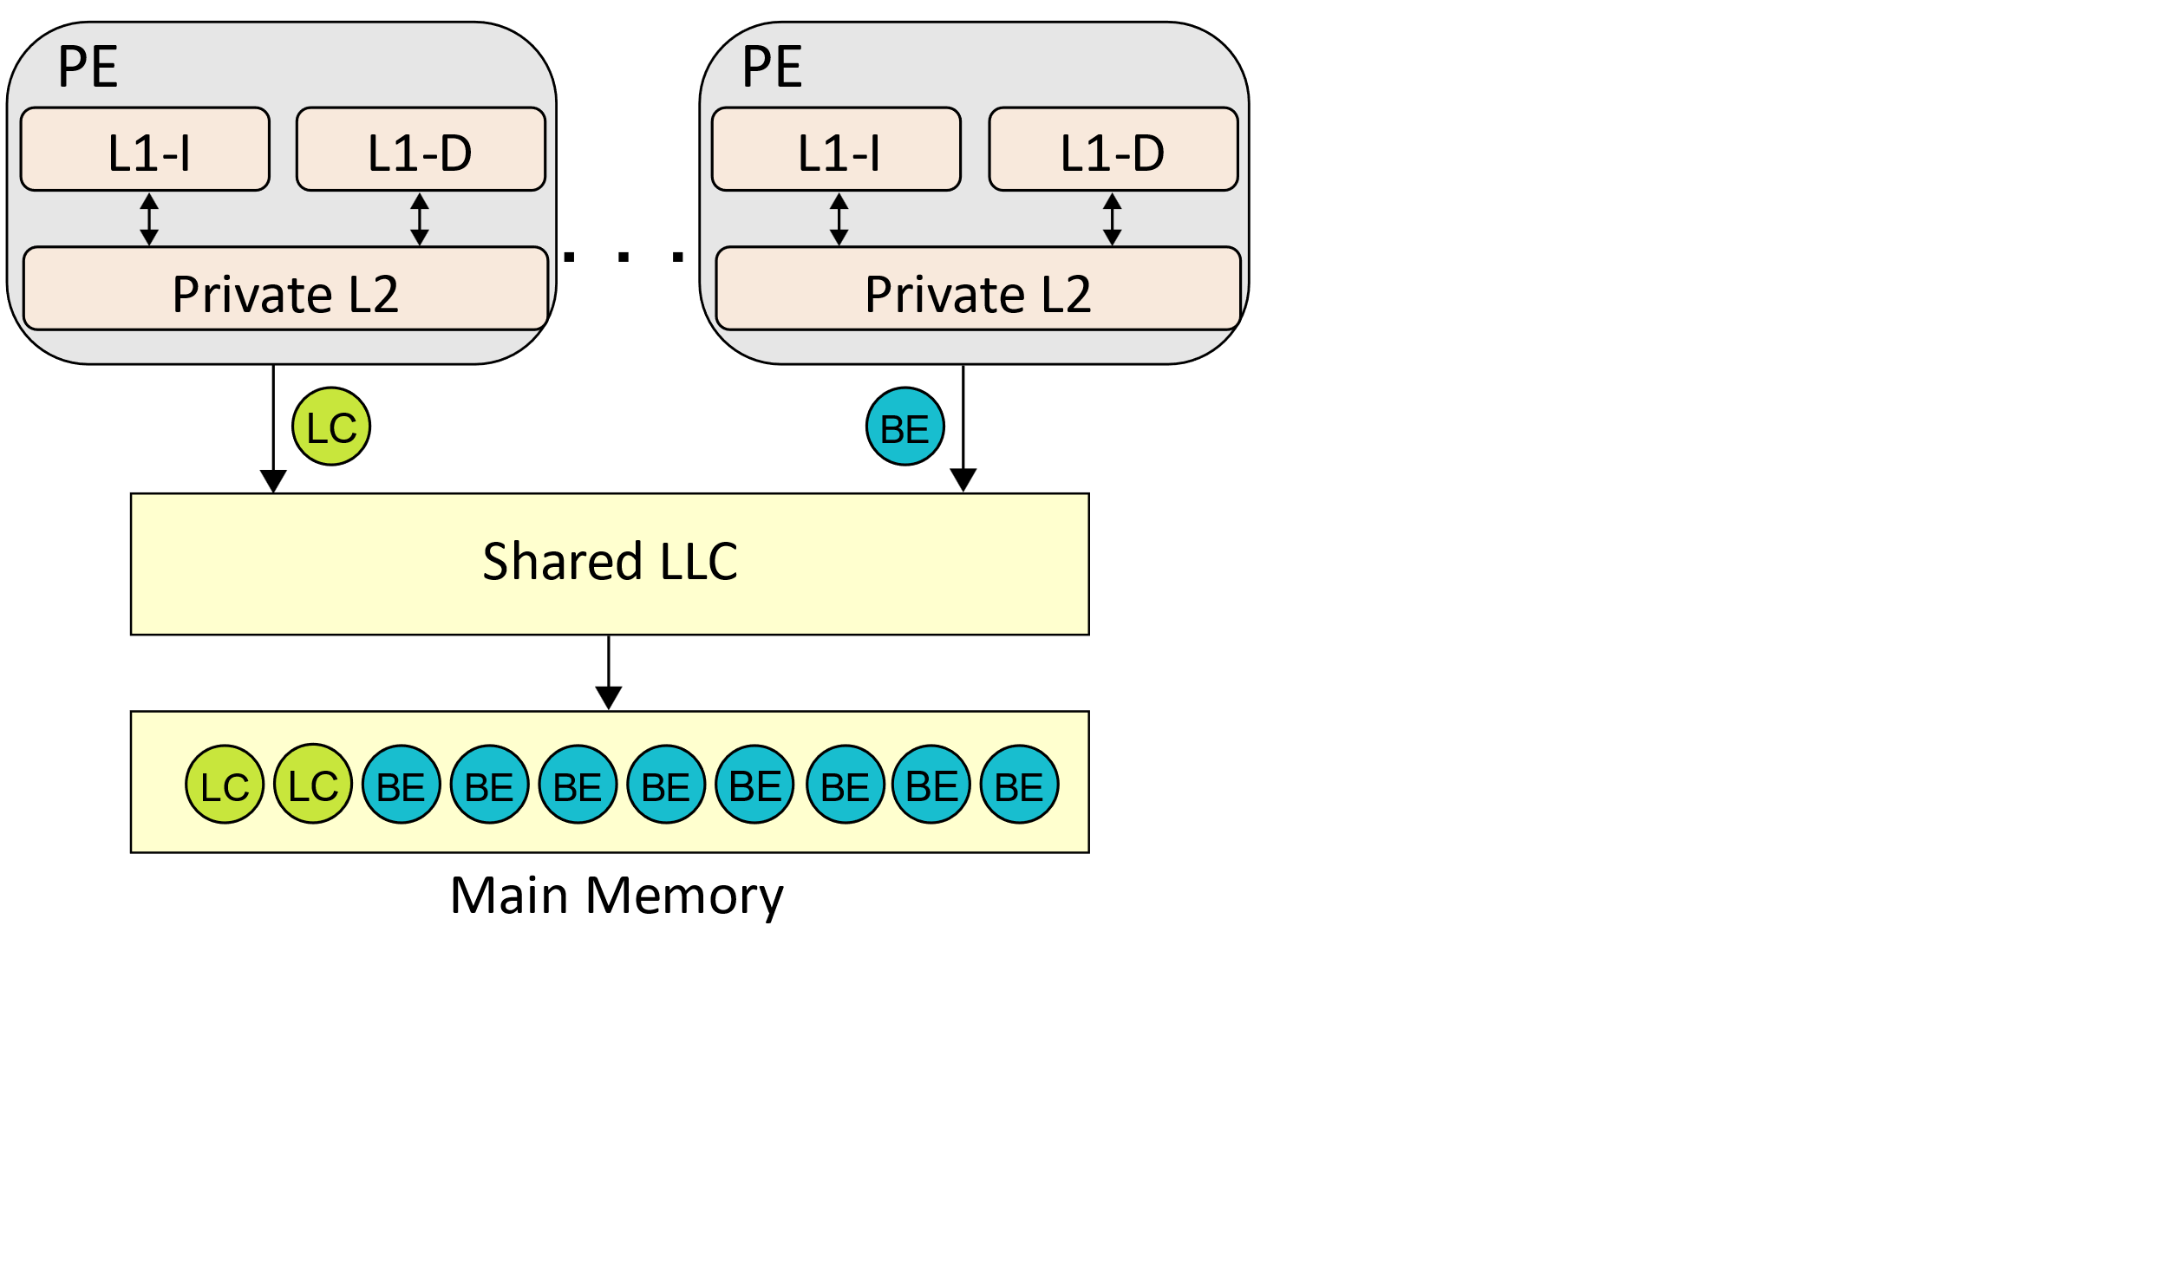
7
Memory Bandwidth Contention in Data Centers
Co-locating leads to contention for shared resources
Co-locating leads to contention for shared res
CPU, LLC, memory bandwidth
Priority inversion
Memory-intensive BE tasks block LC tasks’ requests on the memory access path
Priority inversion
Priority
Inversion!
Notes:
However, simply Co-locating leads to contention for shared resources, such as CPU, LLC, and memory bandwidth.
This contention will lead to priority inversion.
That means, during the execution some memory-intensive BE tasks block LC tasks’ requests on the memory access path.
Our project targets the memory bandwidth contention problem.

Slide 8
8
Memory Bandwidth Partitioning to Alleviate Contention
Modern bandwidth partitioning mechanism
Modern bandwidth partitioning mechanism
Intel MBA^{[1]} and ARM MPAM^{[2]}
[1] H. Andrew, C. Marcel, and K. M. Abbasi. Introduction to memory bandwidth allocation. [Online]. Available: https://software.intel.com/enus/articles/introduction-to-memory-bandwidth-allocation
[2] ARM architecture reference manual supplement memory system resource partitioning and monitoring (mpam) for ARMv8-A. [Online]. Available: https://developer.arm.com/documentation/ddi0598/latest
Notes:
Before introducing our design, let’s review data centers’ existing memory bandwidth partitioning mechanism,
Intel MBA and ARM MPAM,
to solve the contention problem

Slide 9
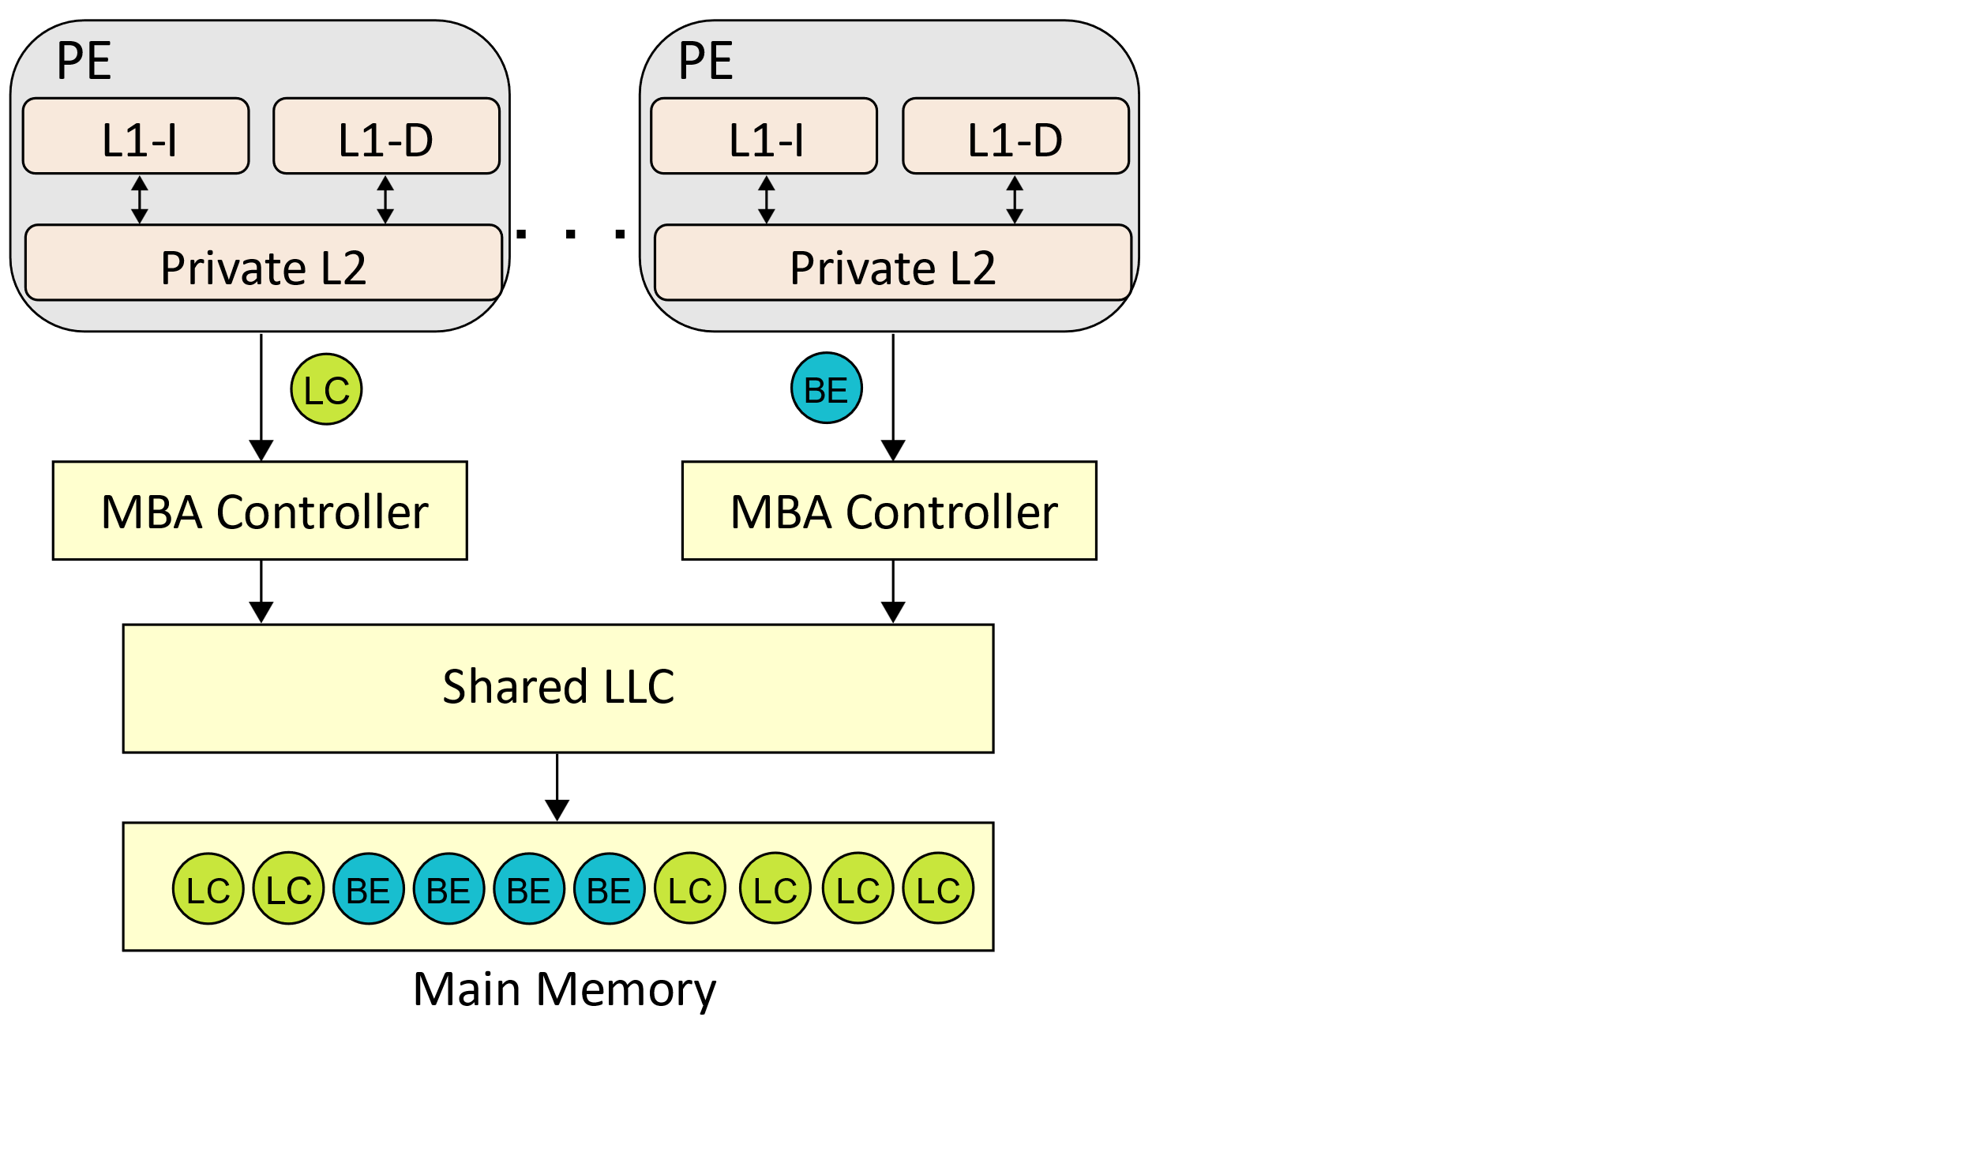
9
Intel MBA to Partition Bandwidth
Intel MBA
Intel MBA
A controller between L2 and LLC
Introducing additional latency
Slow down BE tasks’ request rate to guarantee QoS
Request rate
slow down
Notes:
Intel MBA enforces memory bandwidth limits by introducing a controller for each core between the private L2 cache and the last-level cache.
If a BE thread overuses memory bandwidth, the controller inserts additional delays into its memory accesses
So it can slow down the BE tasks’ request rate and guarantee QoS.

Slide 10
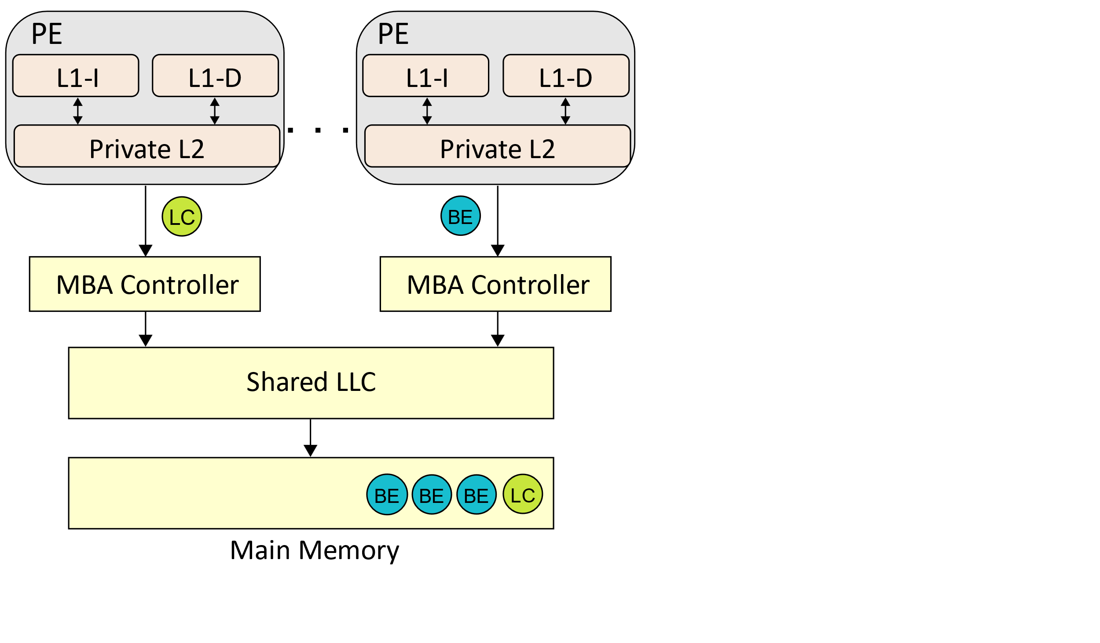
10
Intel MBA to Partition Bandwidth
Intel MBA
A controller between L2 and LLC
Introducing additional latency
Slow down BE tasks’ request rate to guarantee QoS
Intel MBA
Request rate
slow down
What if there are few LC requests before a BE request at a given moment?
Notes:
However, if there are few LC requests before a BE request at a given moment, BE tasks do not need to wait for the latency.

Slide 11
11
Intel MBA to Partition Bandwidth
Intel MBA
A controller between L2 and LLC
Introducing additional latency
Slow down BE tasks’ request rate to guarantee QoS
Low bandwidth utilization
Intel MBA
Request rate
slow down
Shortcoming
Notes:
Hence, the shortcoming of Intel MBA is that the additional latency decreases bandwidth utilization.

Slide 12
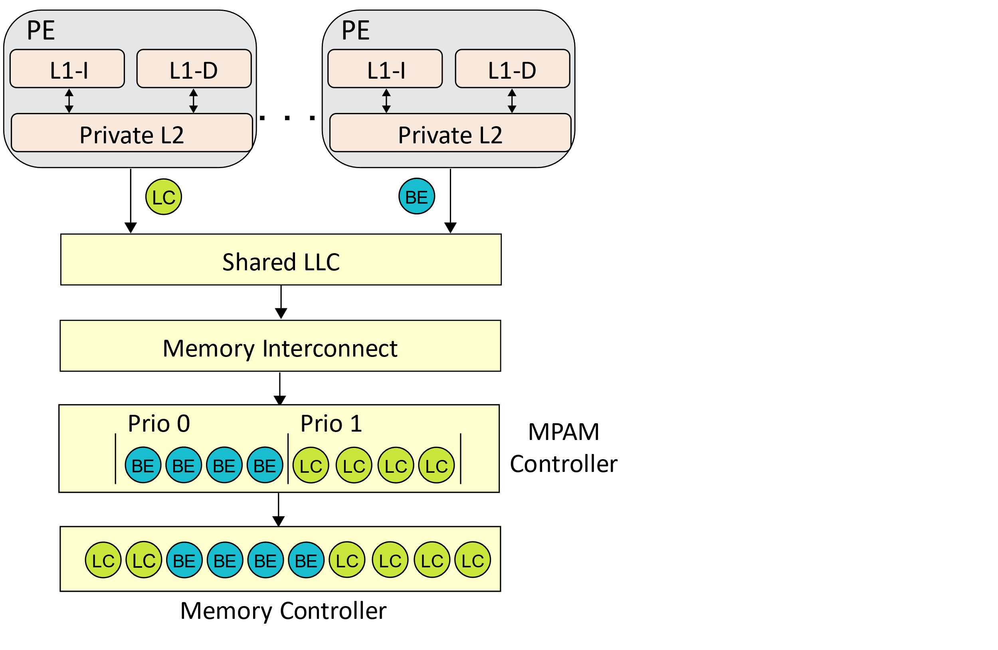
12
ARM MPAM to Partition Bandwidth
ARM MPAM
ARM MPAM
A controller based on priority between the memory interconnect and the memory controller
No additional latency to underutilize bandwidth
Depriorizing BE tasks’ request
Higher Priority
Notes:
In contrast, ARM MPAM enforces bandwidth usage by modifying a controller based on priority between the memory interconnect and the memory controller.
MPAM assigns each thread a priority value based on how much the thread under- or overutilizes the expected bandwidth.
Thus, If requests from different threads are queued at the MPAM controller module, MPAM schedules those requests with priority.
For example, if a LC task needs more bandwidth, the controller will assign its requests with higher priority.

Slide 13
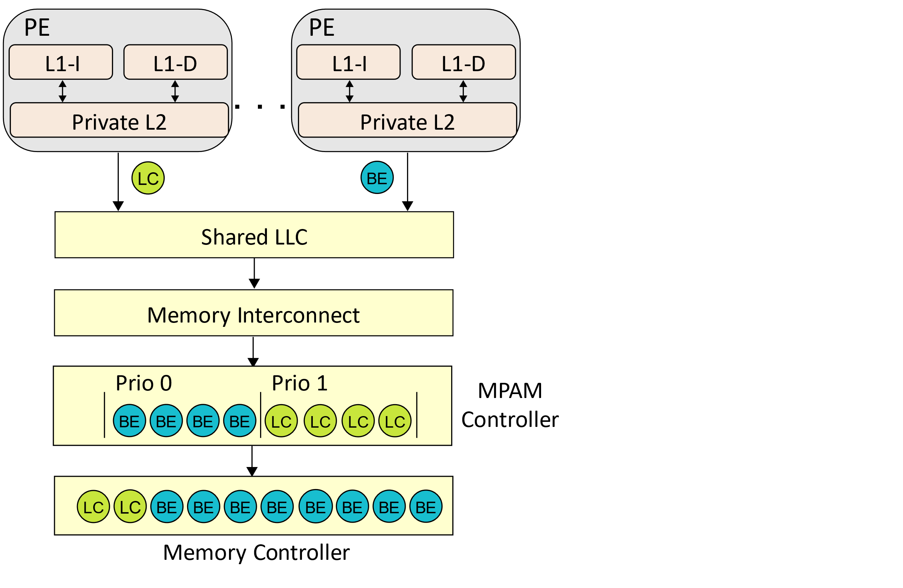
13
ARM MPAM to Partition Bandwidth
ARM MPAM
ARM MPAM
A controller based on priority between the memory interconnect and the memory controller
No additional latency to underutilize bandwidth
Depriorizing BE tasks’ request
What if LC requests are blocked by BE requests in other shared components?
Notes:
However, LC requests can be blocked by BE requests when they are queued in other shared components.

Slide 14
14
ARM MPAM to Partition Bandwidth
ARM MPAM
ARM MPAM
A controller based on priority between the memory interconnect and the memory controller
No additional latency to underutilize bandwidth
Depriorizing BE tasks’ request
Shortcoming
Not enough to guarantee QoS violation
Shortcoming
Notes:
So the MPAM controller is not enough to guarantee QoS.

Slide 15
15
How to balance QoS requirements and bandwidth utilization?
Intel MBA
Pro: can guarantee QoS
Con: underutilize bandwidth
Pro: efficiently utilize bandwidth
Con: lead to QoS violation
ARM MPAM
Notes:
As we mentioned above, Intel MBA can guarantee QoS but underutilize bandwidth, while ARM MPAM can efficiently utilize bandwidth but lead to QoS violation.
So, our design has to solve the problem of How to balance QoS requirements and bandwidth utilization.

Slide 16
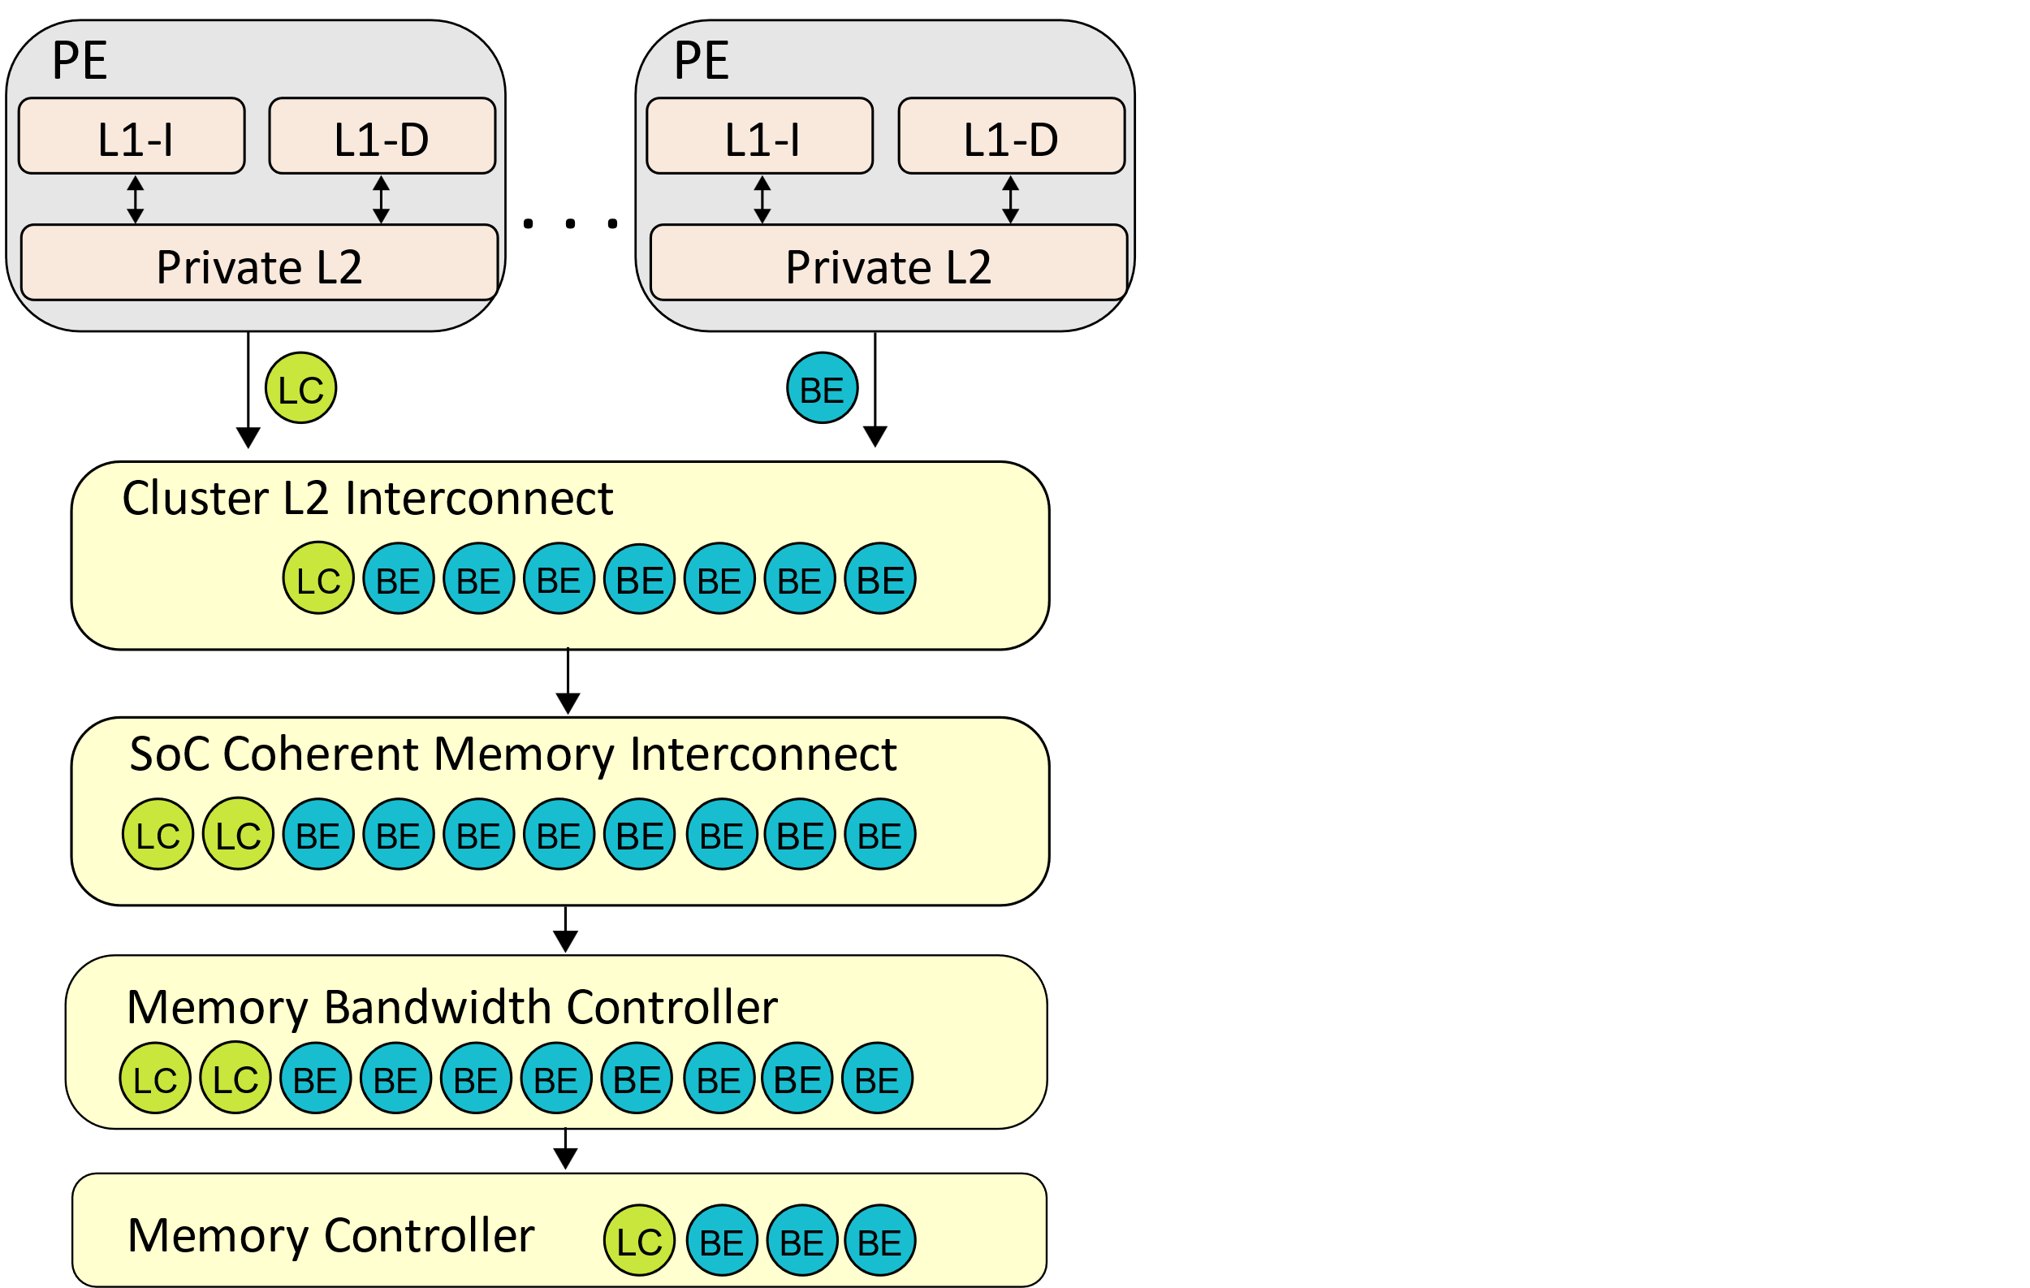
16
How to balance QoS requirements and bandwidth utilization in MPAM?
Requests
L2 Interconnect
Memory interconnect
Memory bandwidth controller
Memory controller
Requests issued by BE tasks block LC tasks in multiple shared components
A single
Virtual queue
Notes:
Since the additional latency that MBA introduced inherently underutilizes bandwidth, we choose to extend MPAM.
So we need to enhance MPAM to guarantee QoS.
An important observation is that requests issued by BE tasks block LC tasks in multiple shared components, such as L2 Interconnect, Memory interconnect, Memory bandwidth controller, Memory controller
Therefore, the queues in multiple components should be viewed as a single virtual queue,

Slide 17
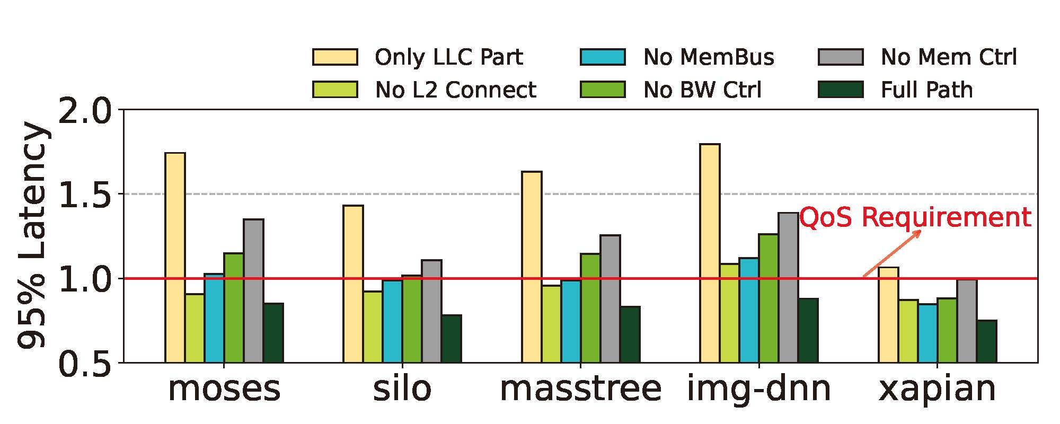
17
How to balance QoS requirements and bandwidth utilization in MPAM?
Requests issued by BE tasks block LC tasks in multiple shared components
Memory access priority must be enforced across all components on the memory path
Setting: Tailbench co-located with memory-intensive BE
Notes:
To demonstrate this, we conduct experiments to cancel each shared component’s priority.
The figure on the right shows the result. The normalized ninety-five percentile latency is with respect to the QoS requirement.
In some cases, canceling any level of priority will result in QoS violations.
So, the first design insight is that Memory access priority must be enforced across all components on the memory path

Slide 18
18
Is full path priority enough?
Notes:
Is full path priority enough to improve bandwidth utilization while guaranteeing QoS?

Slide 19
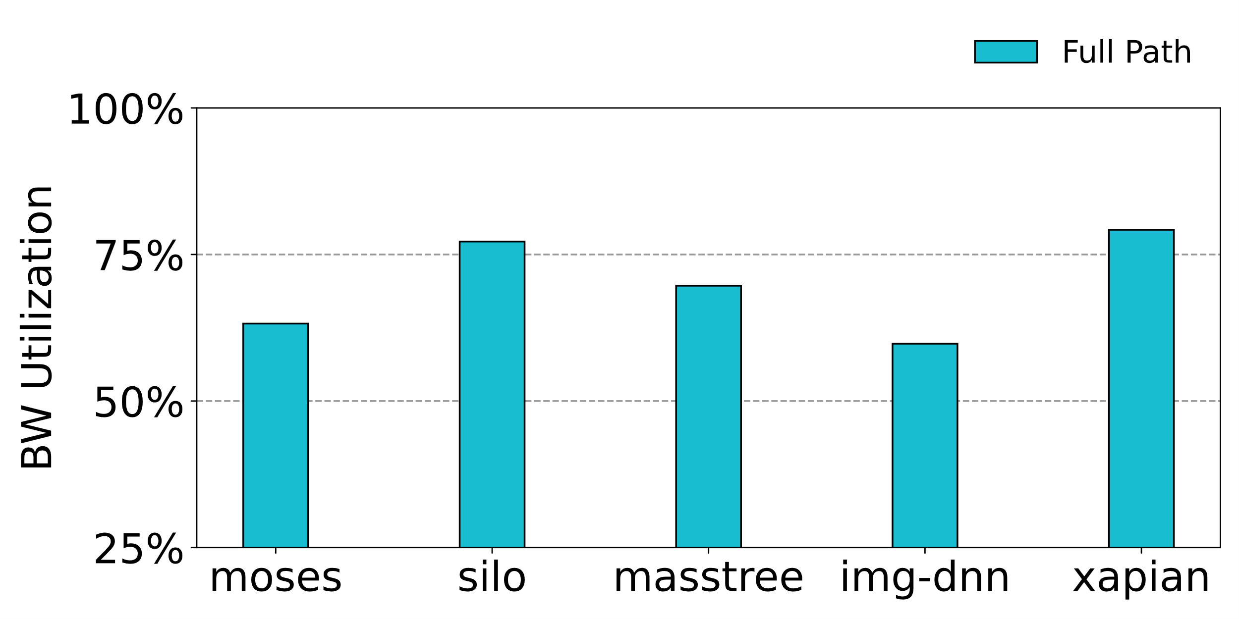
19
Is full path priority enough?
Prioritizing all LC memory accesses
Too conservative!
decreasing bandwidth utilization
Prioritizing all LC memory accesses
40.2%
Setting: Tailbench co-located with memory-intensive BE
Notes:
Our experiments show that prioritizing all LC memory access is too conservative.
The figure shows that full path priority decreases the maximum bandwidth utilization by up to 40.2%
This low utilization rate occurs because prioritizing LC memory accesses often conflicts with each component’s default scheduling algorithm, aiming to maximize memory bandwidth utilization.

Slide 20
20
Is full path priority enough?
Prioritizing all LC memory accesses
Too conservative!
decreasing bandwidth utilization
Conflict with the default algorithm to maximize bandwidth
Thoughts: How about just prioritizing a portion of LC accesses?
Prioritizing all LC memory accesses
Thoughts: How about just prioritizing a portion of LC accesses?
Notes:
Thus, how about just prioritizing a portion of LC accesses?

Slide 21
21
Is full path priority enough?
Prioritizing all LC memory accesses
Too conservative!
decreasing bandwidth utilization
Conflict with the default algorithm to maximize bandwidth
Thoughts: How about just prioritizing a portion of LC accesses?
Which portion?
Prioritizing all LC memory accesses
Thoughts: How about just prioritizing a portion of LC accesses?
Notes:
We need to think about which portion of accesses should be prioritized.

Slide 22
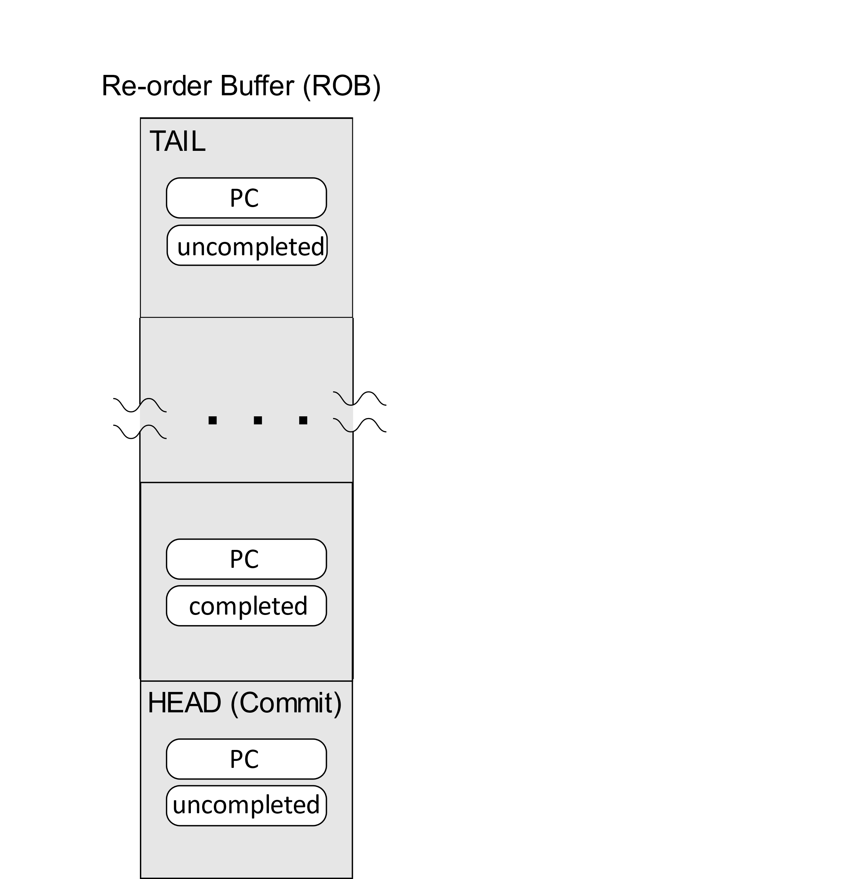
22
Enforcing Memory Access Priority at Instruction-Level
Modern servers perform out-of-order execution
Modern servers perform out-of-order execution
Modern servers perform out-of-order execution
Instructions execute parallel in the CPU
Notes:
A fact is that Modern servers perform out-of-order execution.
So instructions execute parallel in the CPU

Slide 23
23
Enforcing Memory Access Priority at Instruction-Level
Modern servers perform out-of-order execution
Modern servers perform out-of-order execution
Modern servers perform out-of-order execution
Instructions execute parallel in the CPU
Load instructions causing a long stall on ROB
Load instructions causing a long stall on ROB
Load instructions causing a long stall on ROB
Long Stall
Notes:
So we focus on the load instructions causing a long stall on ROB.

Slide 24
24
Enforcing Memory Access Priority at Instruction-Level
Modern servers perform out-of-order execution
Modern servers perform out-of-order execution
Modern servers perform out-of-order execution
Instructions execute parallel in the CPU
Load instructions causing a long stall on ROB
These loads miss CPU caches and access memory
Other instructions are likely to depend on those loads
Load instructions causing a long stall on ROB
Load instructions causing a long stall on ROB
Instruction
Dependency
Long Stall
Notes:
Prioritizing such a selective portion of instructions is most cost-effective in minimizing response latency.
There are two reasons. First, a long stall indicates that the load instruction misses CPU caches and accesses the main memory, so they need to be prioritized.
Second, and more importantly, a long stall implies that other instructions are likely to depend on other instructions.
Prioritizing the scheduling of such load instructions enables them and all the dependent instructions to retire faster, thereby effectively minimizing latency

Slide 25
25
Enforcing Memory Access Priority at Instruction-Level
Modern servers perform out-of-order execution
Modern servers perform out-of-order execution
Instructions execute parallel in the CPU
Load instructions causing a long stall on ROB
These loads miss CPU caches and access memory
Other instructions are likely to depend on those loads
Only scheduling performance-critical memory access instructions
Load instructions causing a long stall on ROB
Instruction
Dependency
Only scheduling performance-critical memory access instructions
Long Stall
Notes:
So, we decide to schedule those performance-critical memory access instructions.

Slide 26
26
Enforcing Memory Access Priority at Instruction-Level
Huge instruction footprint in data centers
Difficult to track all loads
Huge instruction footprint in data centers
Notes:
However, given the fact that the instruction footprint of data center applications is growing larger,
It is difficult for us to track all loads, for example, using a hardware data structure to storage information of all load instructions.

Slide 27
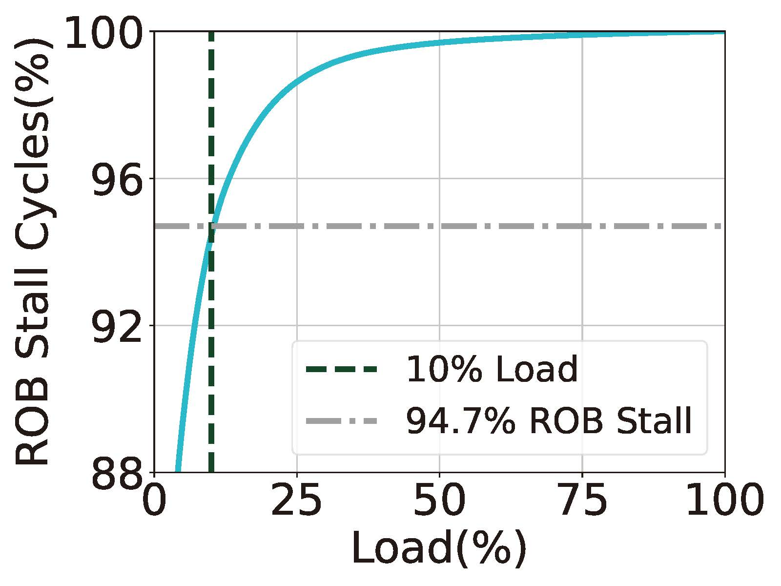
27
Enforcing Memory Access Priority at Instruction-Level
Huge instruction footprint in data centers
Difficult to track all loads
Fewer than 10% of the load instructions cause over 95% of the ROB stall cycles
Opportunity to identify performance-critical loads
Huge instruction footprint in data centers
Fewer than 10% of the load instructions cause over 95% of the ROB stall cycles
Setting: Silo (database application) co-located with memory-intensive BE tasks
Notes:
However, as shown in the figure on the right, we observed that fewer than 10% of the load instructions caused over 95% of the ROB stall cycles when LC tasks co-located with memory-intensive BE tasks.
So this gives us an opportunity to identify performance-critical loads.

Slide 28
28
Design Insights
Issue: QoS violation occurs due to bandwidth contention
Issue: QoS violation occurs due to bandwidth contention
Insight #1: Memory access priority must be enforced across all components on the memory path
Notes:
In this case, we have two design insights.
First, to avoid QoS violation, memory access priority must be enforced across all components on the memory path

Slide 29
29
Design Insights
Issue: QoS violation occurs due to bandwidth contention
Issue: QoS violation occurs due to bandwidth contention
Insight #1: Memory access priority must be enforced across all components on the memory path
Issue: Prioritizing all LC access $→$ low bandwidth utilization
Insight #2: Identifying and prioritizing the portion of performance-critical load instructions
Issue: Prioritizing all LC access $→$ low bandwidth utilization
Notes:
Second, to efficiently utilize bandwidth, we can identify and prioritize the portion of performance-critical load instructions.

Slide 30
30
Design Challenge
Challenge: How to identify critical load in data center applications?
Notes:
Based on these insights, our design needs to solve the key challenge: How to identify critical load in data center applications

Slide 31
31
Design Challenge
Challenge: How to identify critical load in data center applications?
General
Relying on a few commonly available hardware features
Lightweight
Incurring minimal performance and storage overhead to face huge instruction footprint
General
Lightweight
Notes:
In addition, our design should meet the following goals.
First, our design only relies on a few commonly available hardware features.
Second, our design should to be lightweight and incur minimal overhead.

Slide 32
32
Pivot
Criticality-Aware Instruction-Centric Bandwidth
Partitioning for Data Center Applications
Notes:
In this case, we propose Pivot, an instruction-centric bandwidth partitioning mechanism.

Slide 33
33
How to identify critical load？
General
Utilizing instruction tracing and performance monitoring tools
Lightweight
Only a portion of loads lead to almost all ROB stall cycles
Offline profiling to reduce loads that need to be tracked
A two-phase profiling approach
General
Lightweight
Notes:
First, to be general, pivot utilizes instruction tracing and performance monitoring tools, which are widely used in modern data centers.
Second, since only a portion of loads lead to almost all ROB stall cycles, we can use offline profiling to reduce loads that need to be tracked.
So, Pivot introduces a two-phase profiling approach.

Slide 34
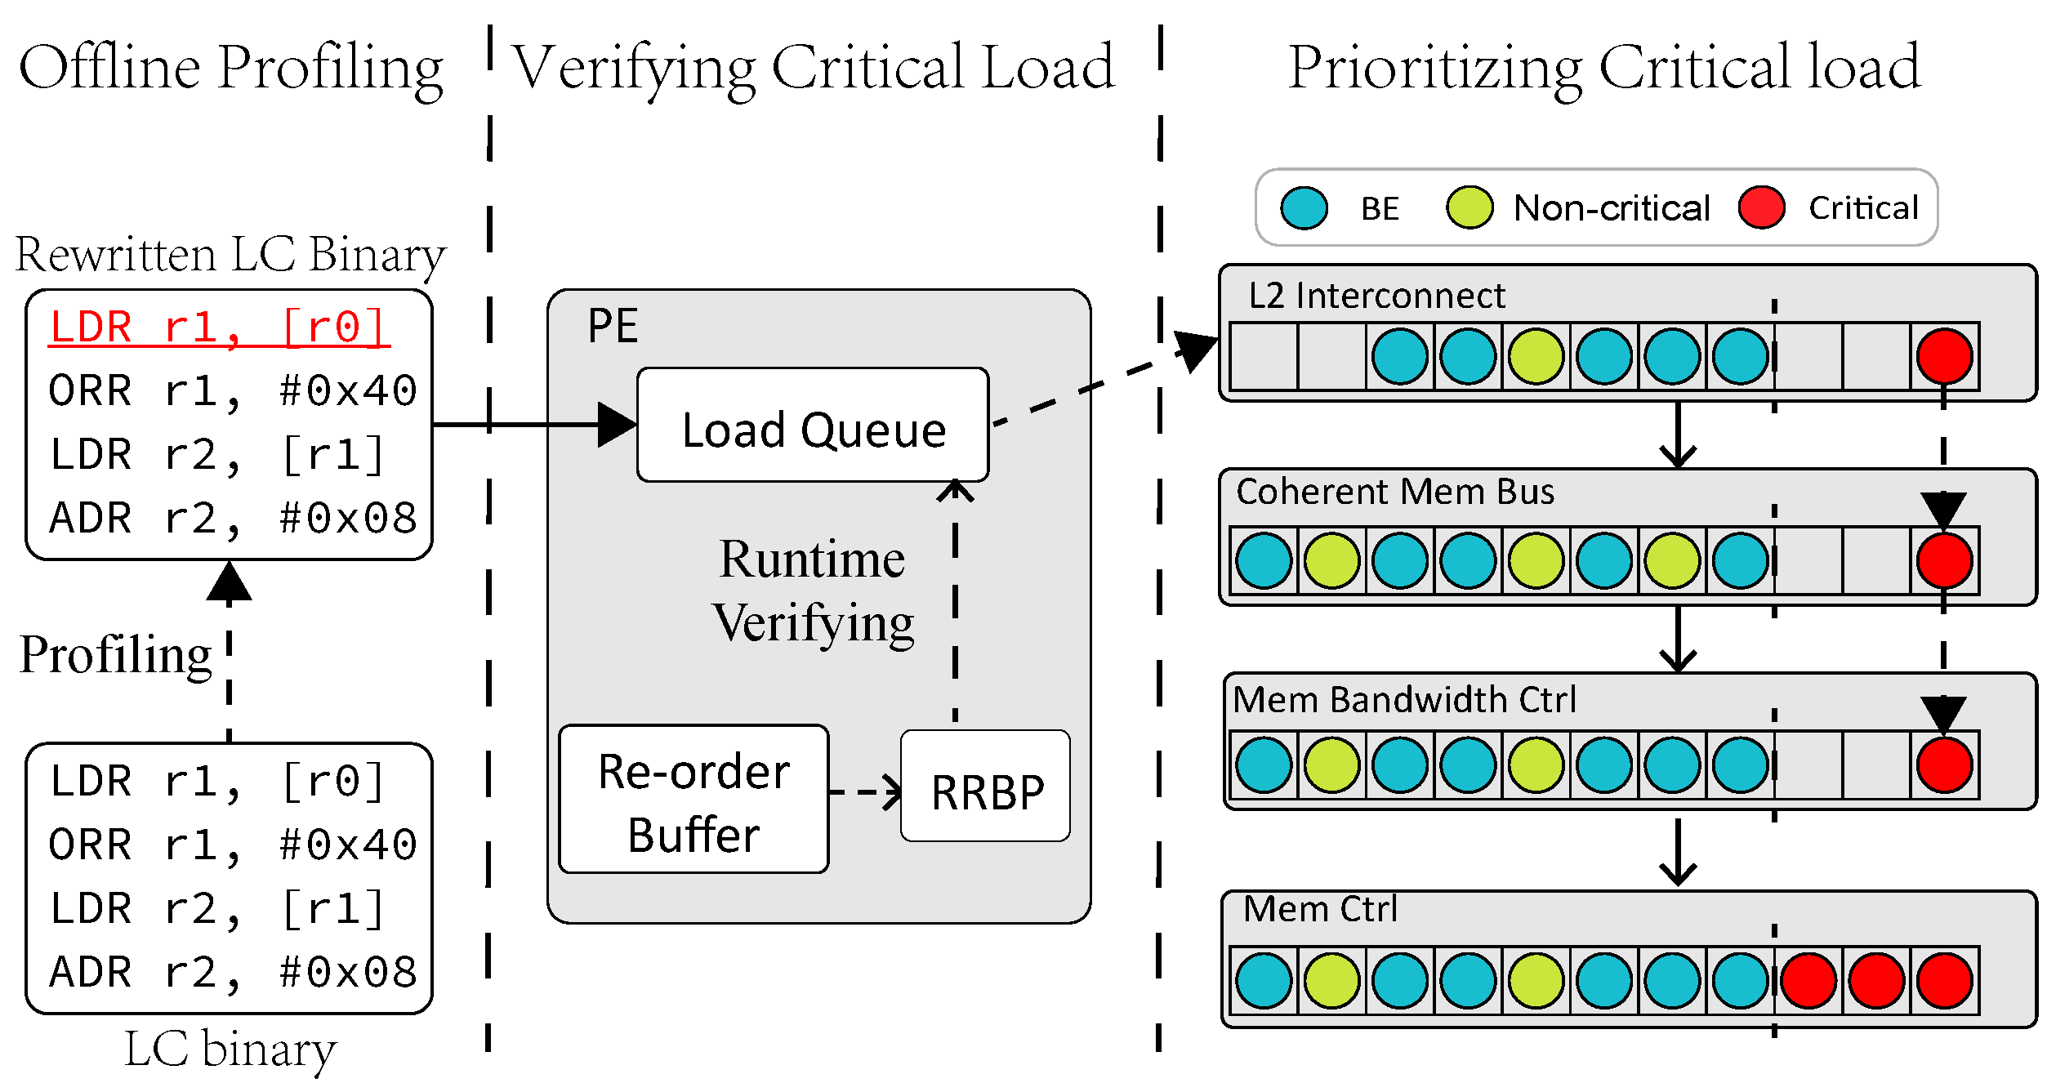
34
Pivot
An instruction-centric memory bandwidth partitioning solution for data center applications
A two-phase profiling approach to predict performance-critical loads
Offline profiling
Offline profiling
Marking potentially critical loads
Minimizing storage and monitoring overhead
Verifying critical load
Load criticality is different in co-location scenarios
Prioritizing critical load
To meet QoS requirements
Verifying critical load
Prioritizing critical load
Notes:
Our design can be divided into three parts, offline profiling, online critical load verifying, and prioritizing critical loads.
The offline profiling stage is to filter highly non-critical load, in order to minimize storage and monitoring overhead.
The online verifying stage is to determine real-time load criticality in the different co-location scenarios.
And Prioritizing the critical load on the full path to meet QoS requirements.

Slide 35
35
Offline Profiling
Co-running the LC and stress BE tasks
The BE task consumes extensive memory bandwidth
The load instructions that remain non-critical have good locality or instruction-level parallelism
Co-running the LC and stress BE tasks
Notes:
In the offline profiling stage, Pivot runs a LC task with stress BE tasks and using performance monitoring and instruction tracing tools to collect information.
The BE consumes extensive memory bandwidth.
So If a load still do not cause long ROB stall means that it may hit the private cache.
Thus, the loads that remain non-critical in this scenarios have good locality and instruction level parallelism.
Thus, Pivot will not marked it as potentially critical.

Slide 36
36
Offline Profiling
Co-running the LC and stress BE tasks
The BE task consumes extensive memory bandwidth
The load instructions that remain non-critical have good locality or instruction-level parallelism
Analyzing and flagging potentially critical load
Co-running the LC and stress BE tasks
Analyzing and flagging potentially critical load
Notes:
Then, Pivot analyzes the information based on several threshold to filter non-critical loads.

Slide 37
37
Offline Profiling
Co-running the LC and stress BE tasks
The BE task consumes extensive memory bandwidth
The load instructions that remain non-critical have good locality or instruction-level parallelism
Analyzing and flagging potentially critical load
Rewriting the binary to mark loads as potentially critical by an extra bit
Co-running the LC and stress BE tasks
Analyzing and flagging potentially critical load
Notes:
And then Pivot rewrites the binary to mark loads as potentially critical by an extra bit

Slide 38
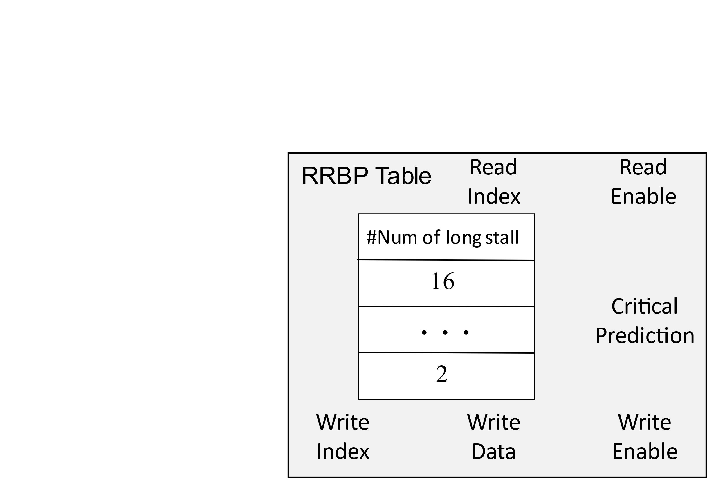
38
Identifying Performance Critical loads
Runtime ROB Block Predictor (RRBP) Table
Runtime ROB Block Predictor (RRBP) Table
Tracking the number of times a load causes a long ROB stall
Only Measuring potentially critical loads’ ROB stall cycles
Reading from the RRBP table when a load enters the load queue
Notes:
In the online profiling stage, Pivot introduces a new data structure Runtime ROB Block Predictor Table, to track the number of times a load causes a long ROB stall.
The Predictor only measures ROB stall cycles of the loads that was marked as potentially critical in the offline stage.
When a load enters the load queue, pivot retrieves the load in the table to determine the load criticality.

Slide 39
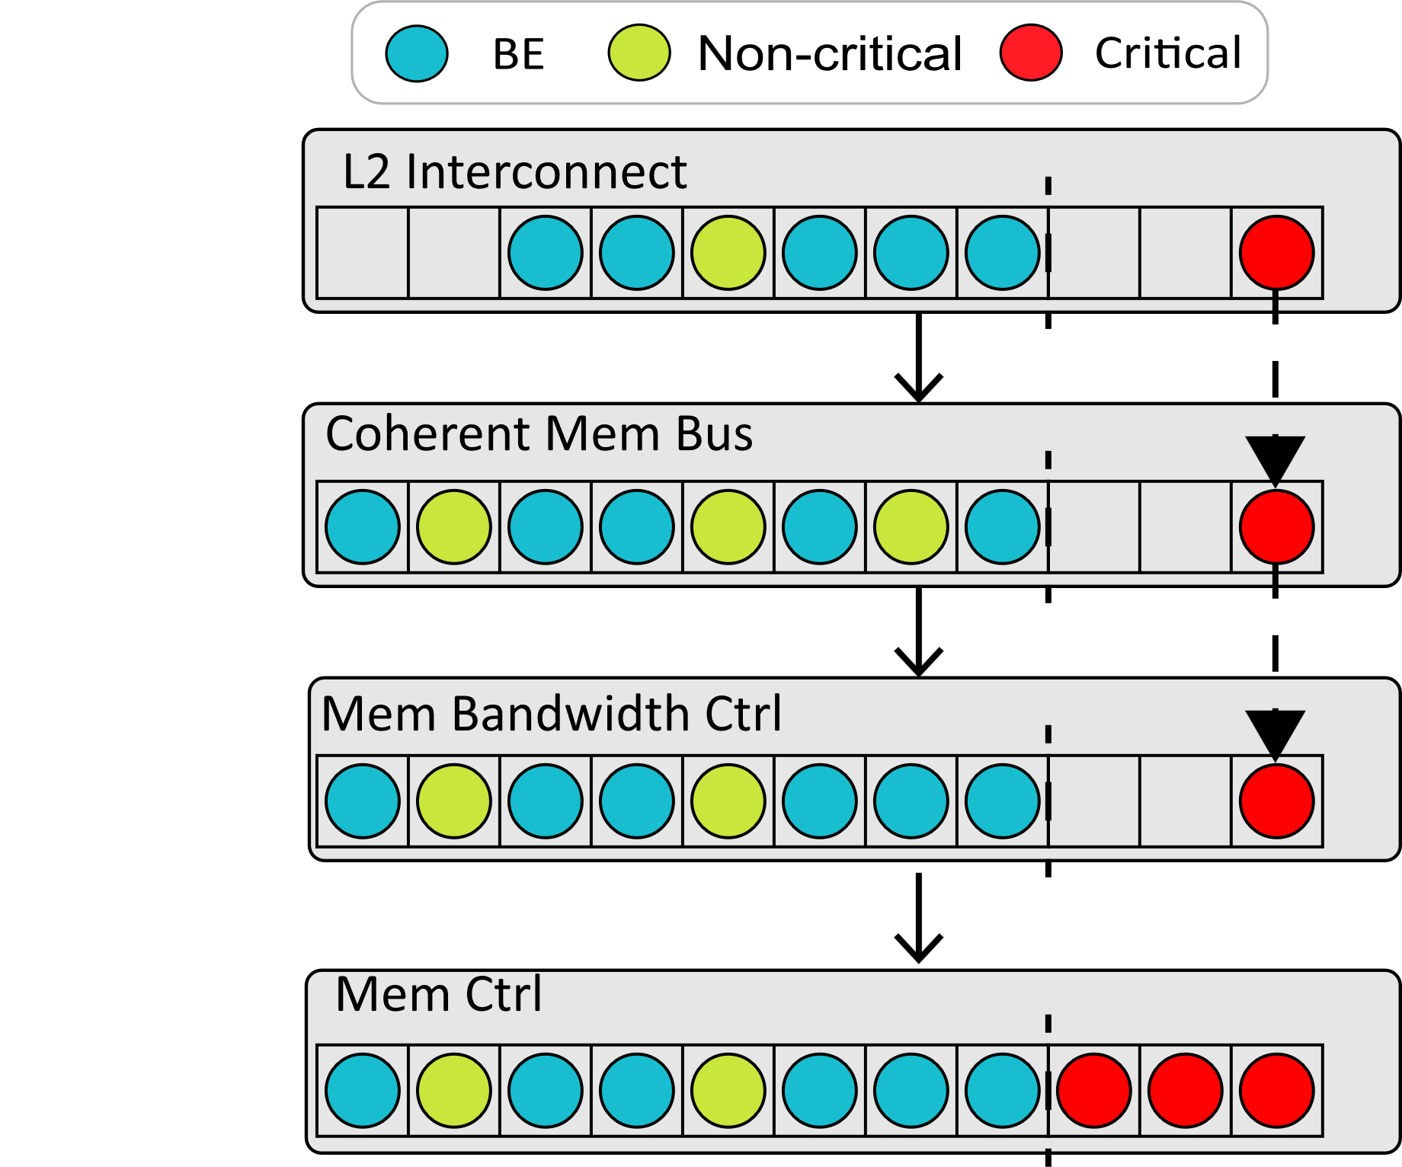
39
Prioritizing Scheduling Performance-Critical Loads
Introducing a priority queue for each memory system component
Preventing blocks due to a lack of space
Implementing a maximum waiting cycle to prevent starvation
Notes:
To prioritize critical loads, Pivot introduces a priority queue for each memory system component to Prevent blocks due to a lack of space.
And Pivot implemented a a maximum waiting cycle to prevent starvation.

Slide 40
40
Evaluation Setup
Gem5 to Model Huawei Kunpeng920
LC Tasks
Tailbench ^{[3]}
BE Tasks
iBench ^{[4]} & CloudSuite ^{[5]}
LC Tasks
BE Tasks
[3] H. Kasture and D. Sanchez, “Tailbench: a benchmark suite and evaluation methodology for latency-critical applications,” in 2016 IEEE International Symposium on Workload Characterization (IISWC), 2016, pp. 1–10.
[4] C. Delimitrou and C. Kozyrakis, “iBench: Quantifying interference for datacenter applications,” in 2013 IEEE International Symposium on Workload Characterization (IISWC), 2013, pp. 23–33.
[5] [Online]. Available: https://github.com/parsa-epfl/cloudsuite/
Notes:
To evaluate Pivot, we use Gem5 to mode Huawei Kunpeng920.
Moreover, our experiments use Tailbench as LC tasks, iBench and CloudSuite as BE tasks.

Slide 41
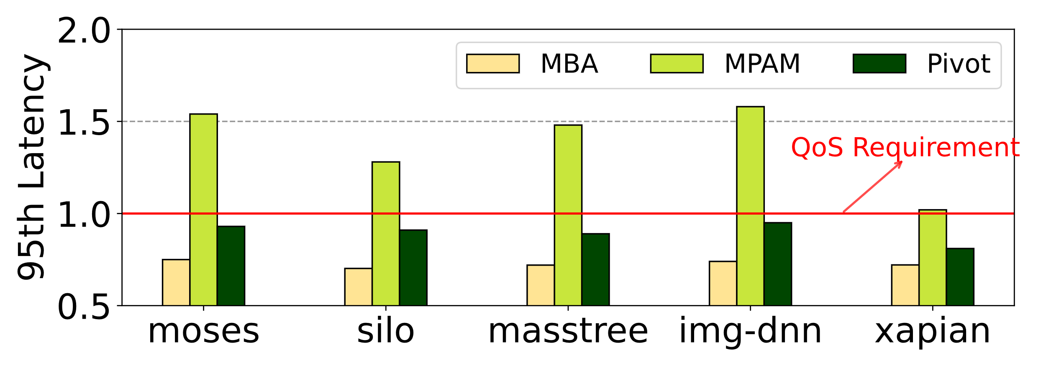
41
Evaluation
Not lead to QoS violation when the LC task is co-located with BE tasks
No QoS violation
Setting: Tailbench co-located with memory-intensive BE
Notes:
We compared Pviot with other approaches.
We can see that unlike MPAM, which may lead to QoS violation, Pivot can meet the QoS requirement.

Slide 42
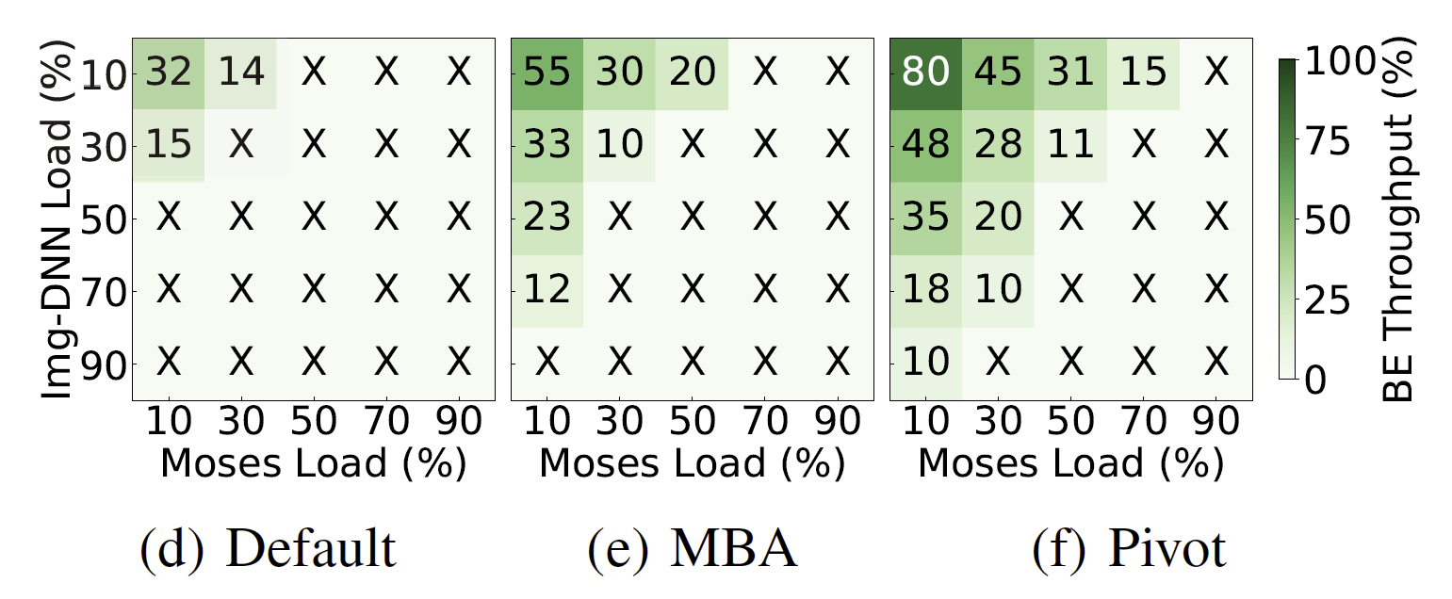
42
Evaluation
Increasing the throughput of the BE applications by up to 2.76× compared to MBA
2.76× throughput
Notes:
Pivot also increases the throughput of the BE applications by up to 2.76× compared to MBA.

Slide 43
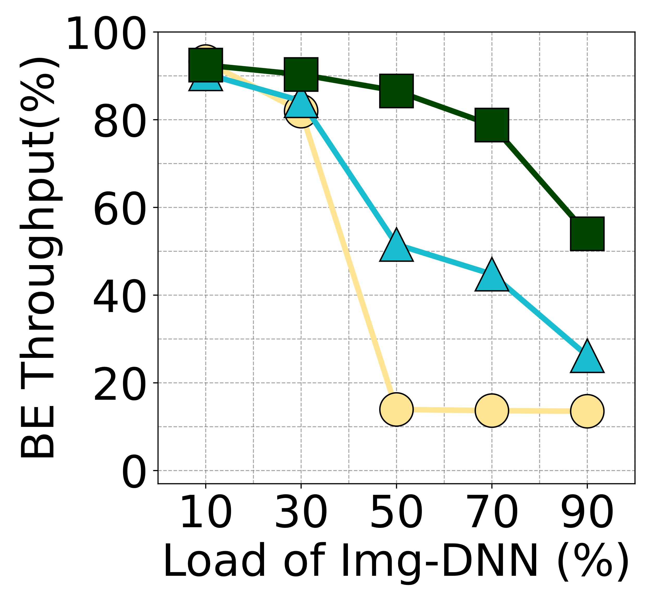
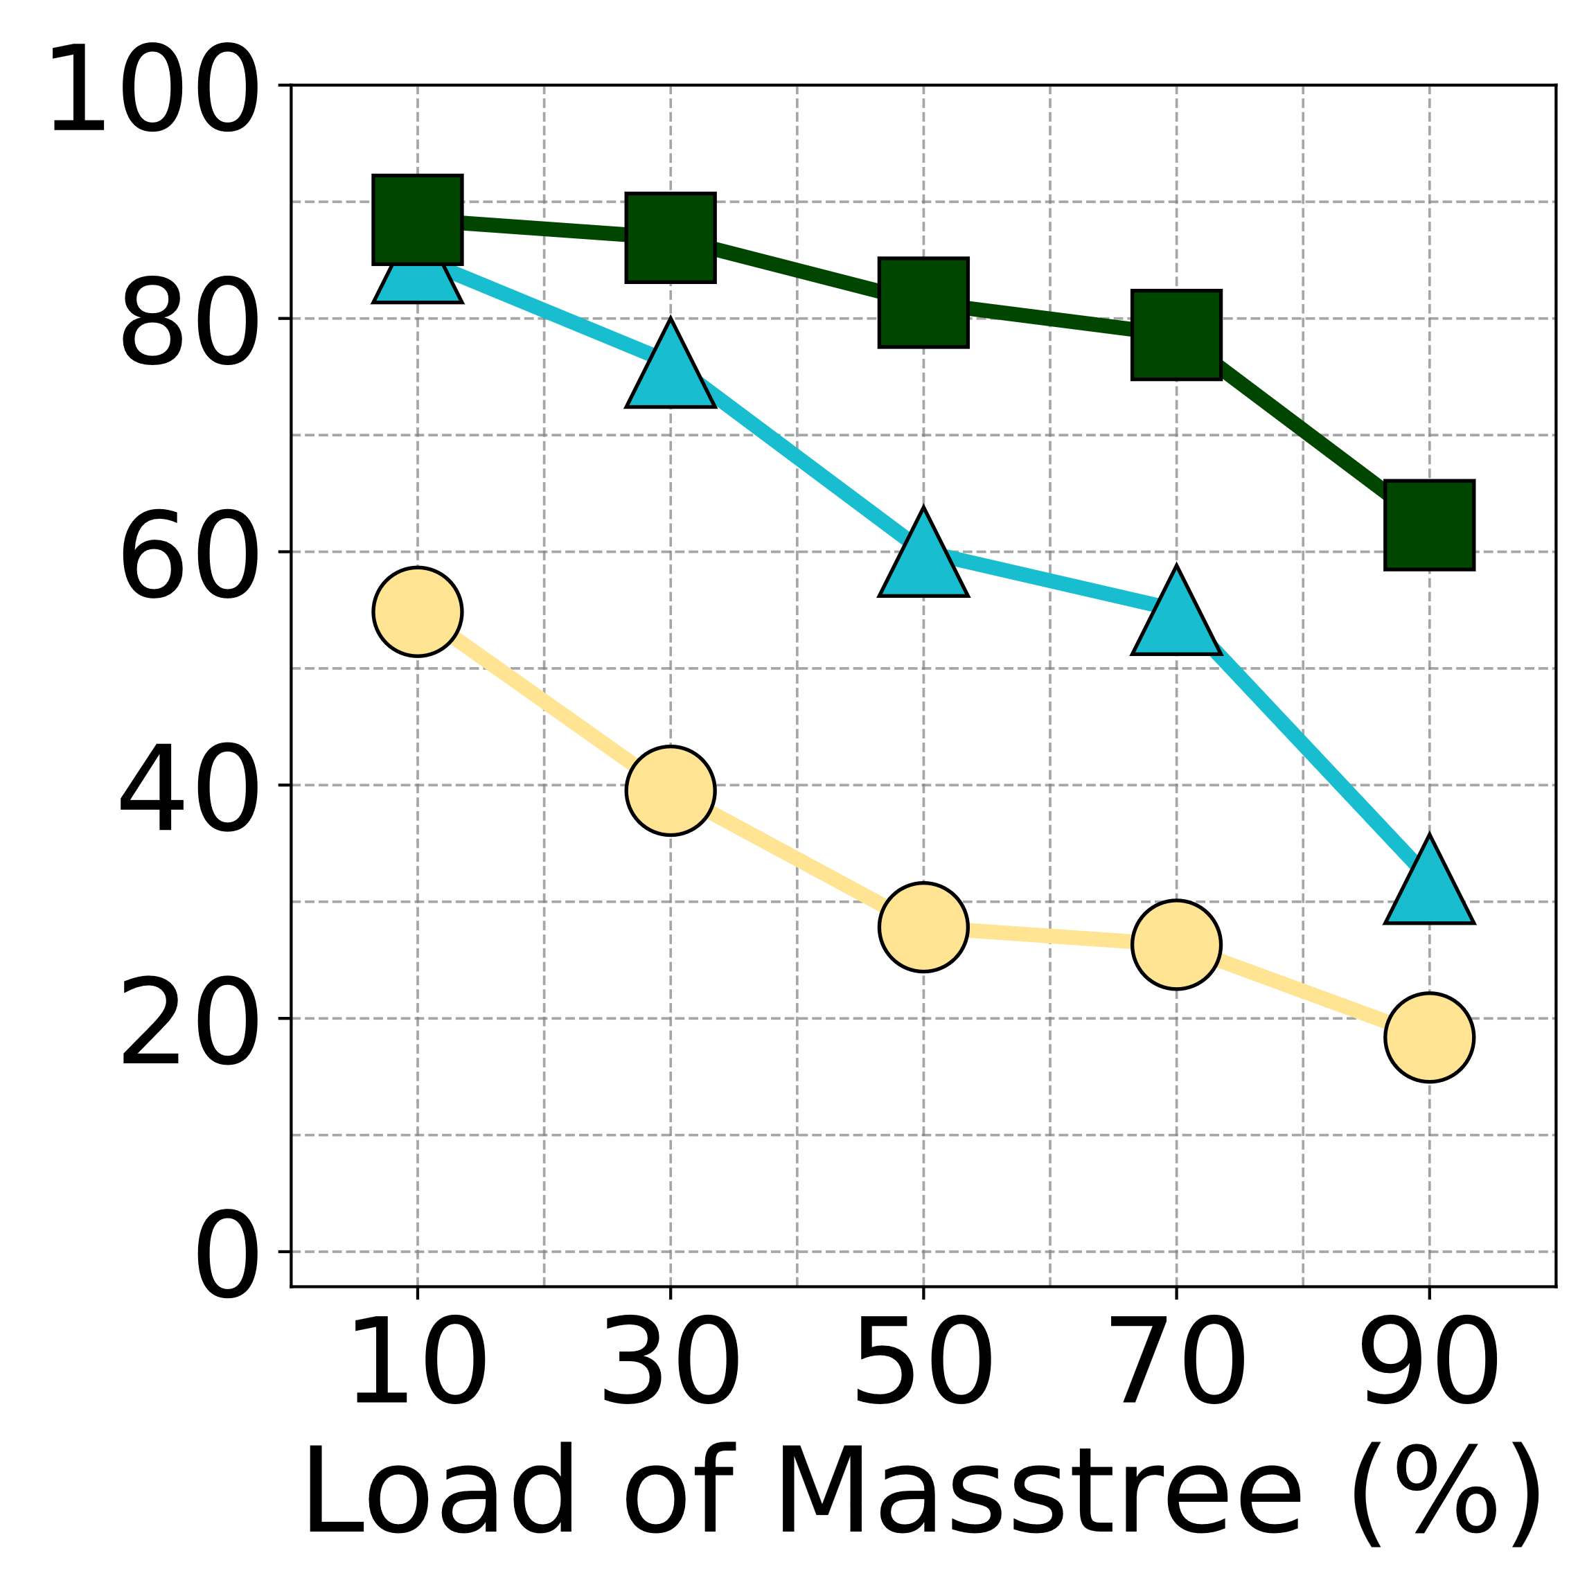
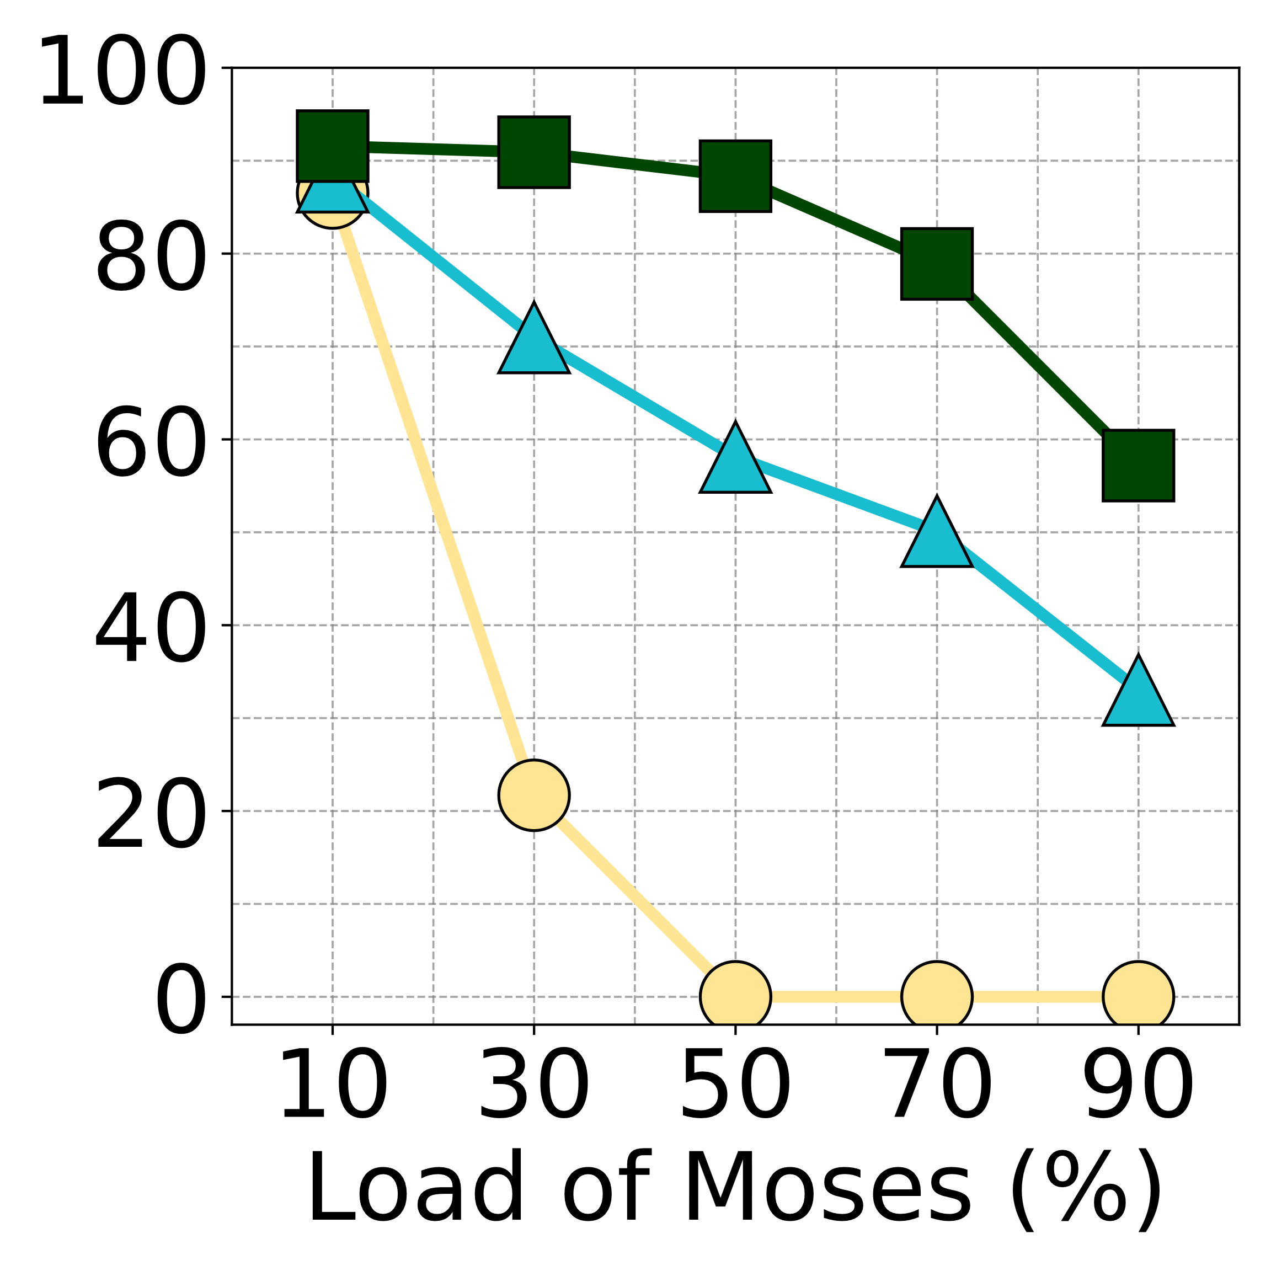
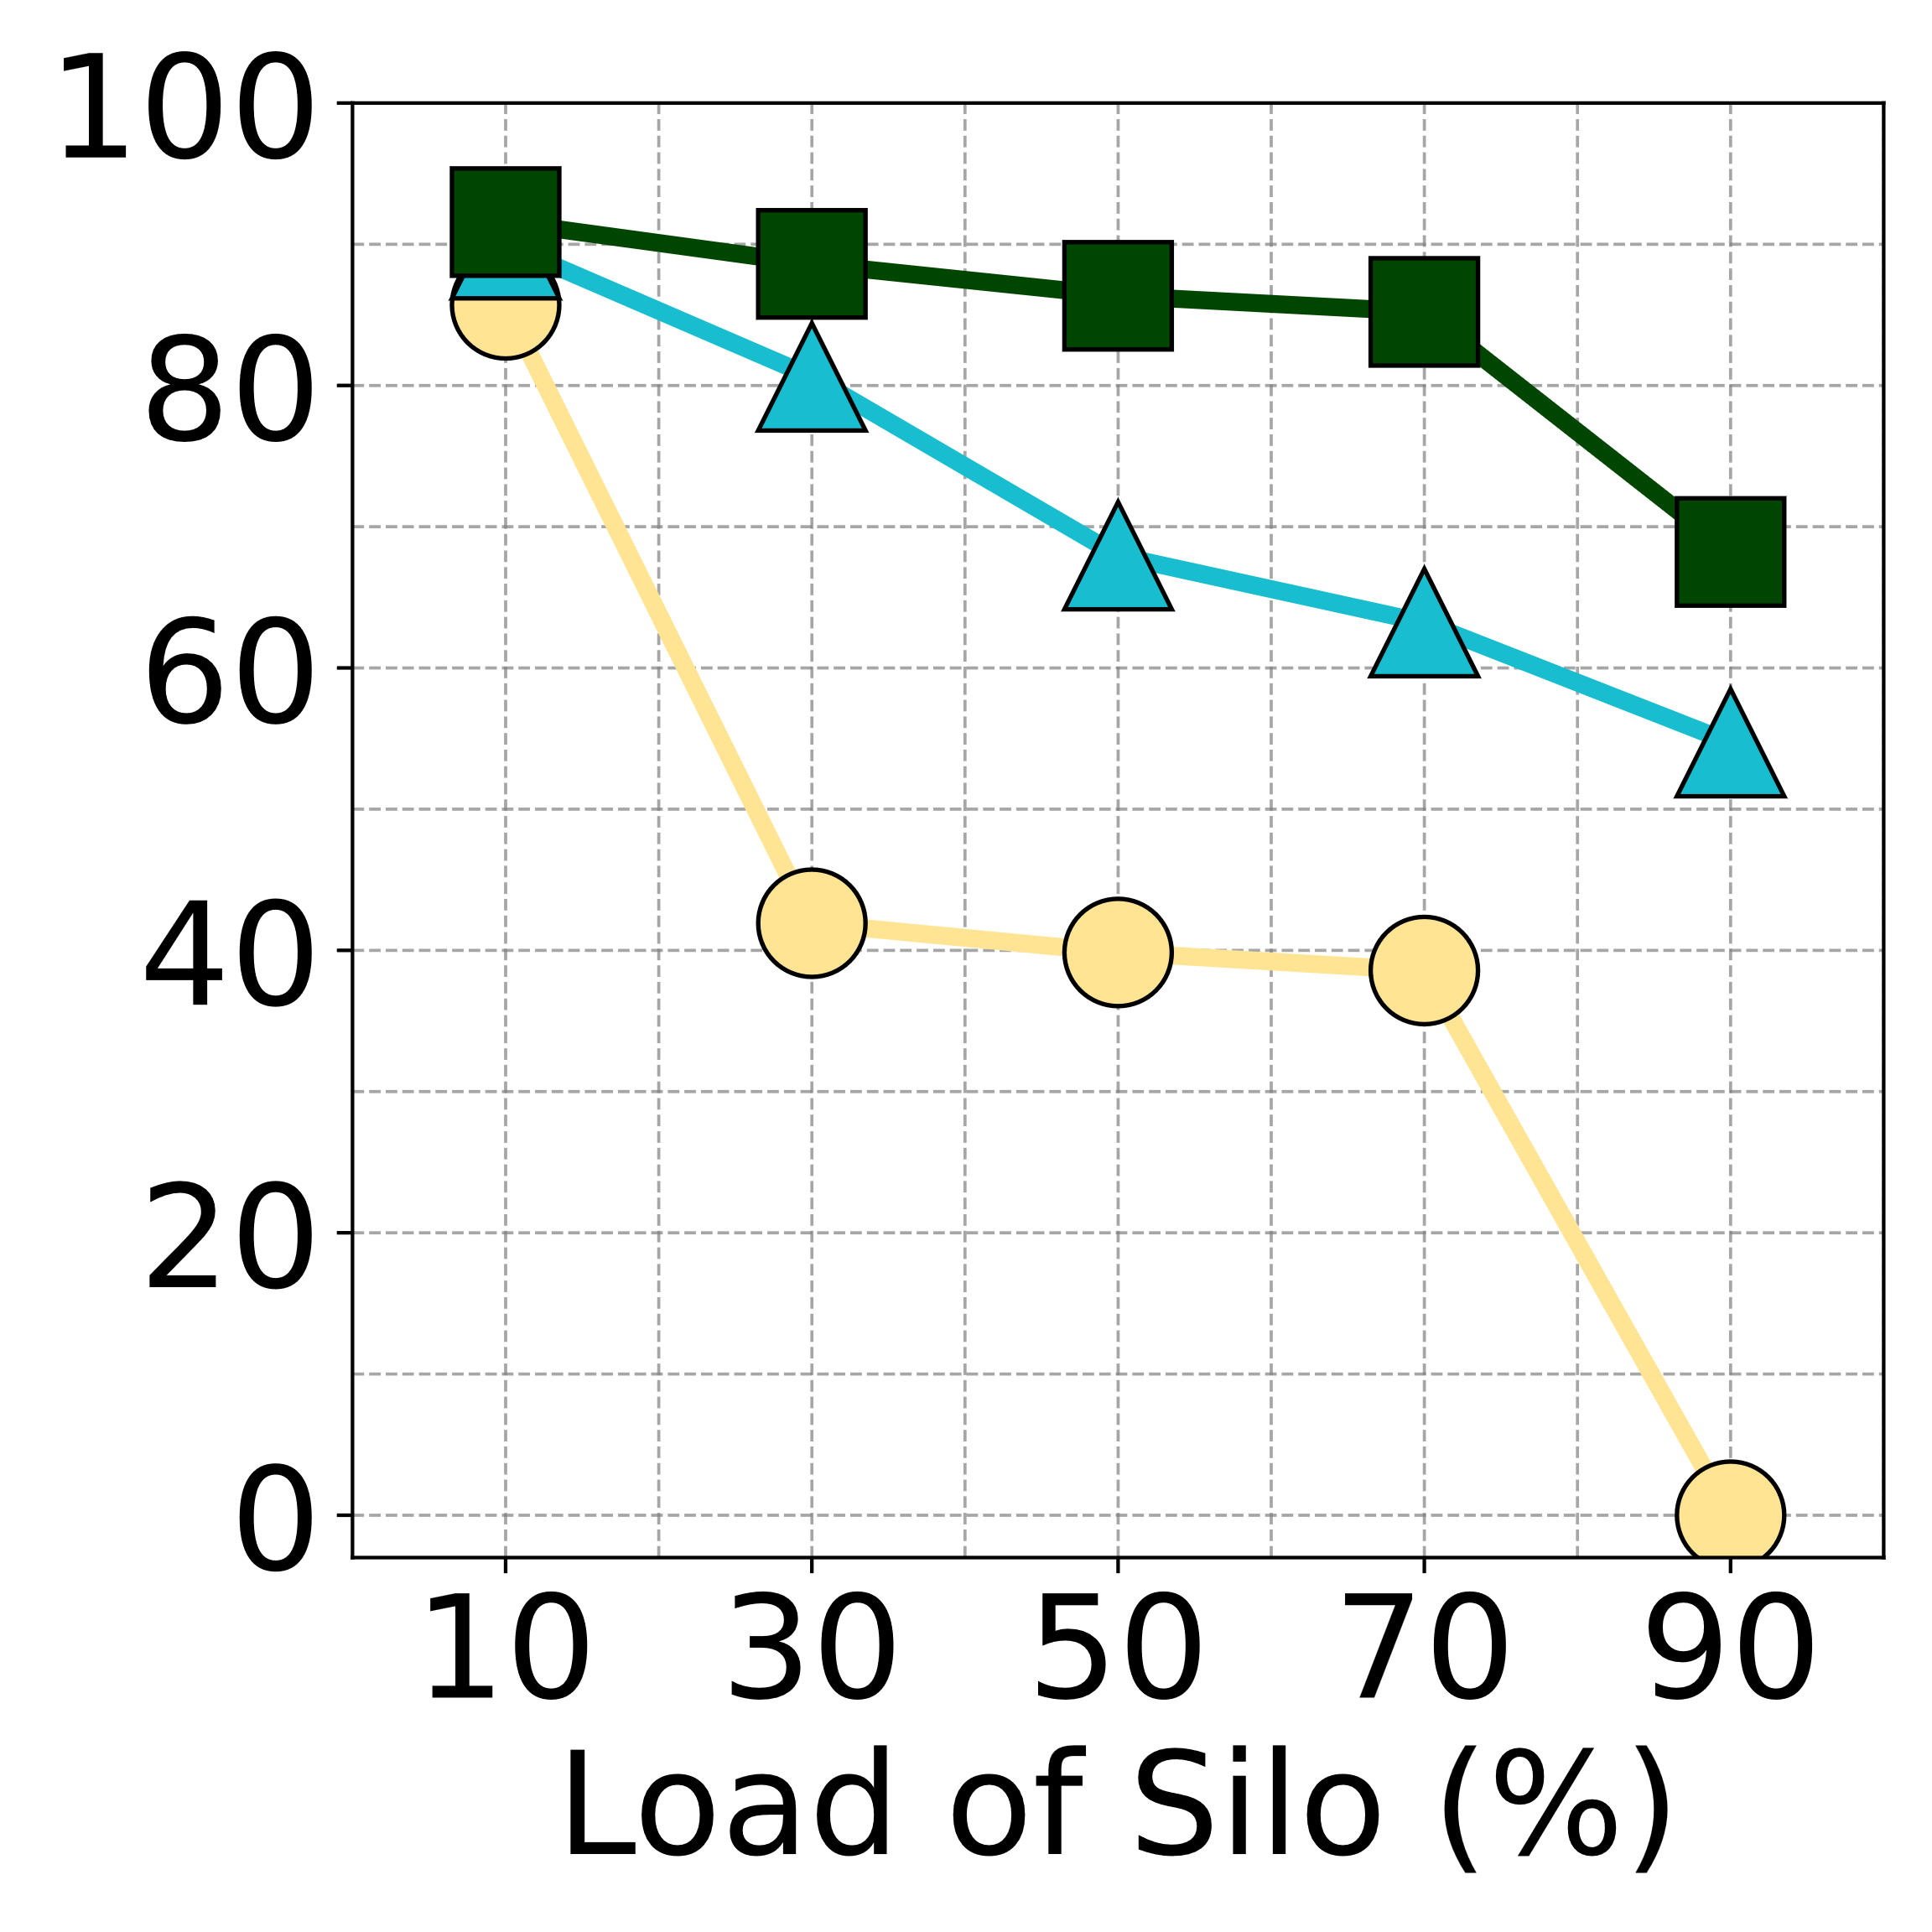
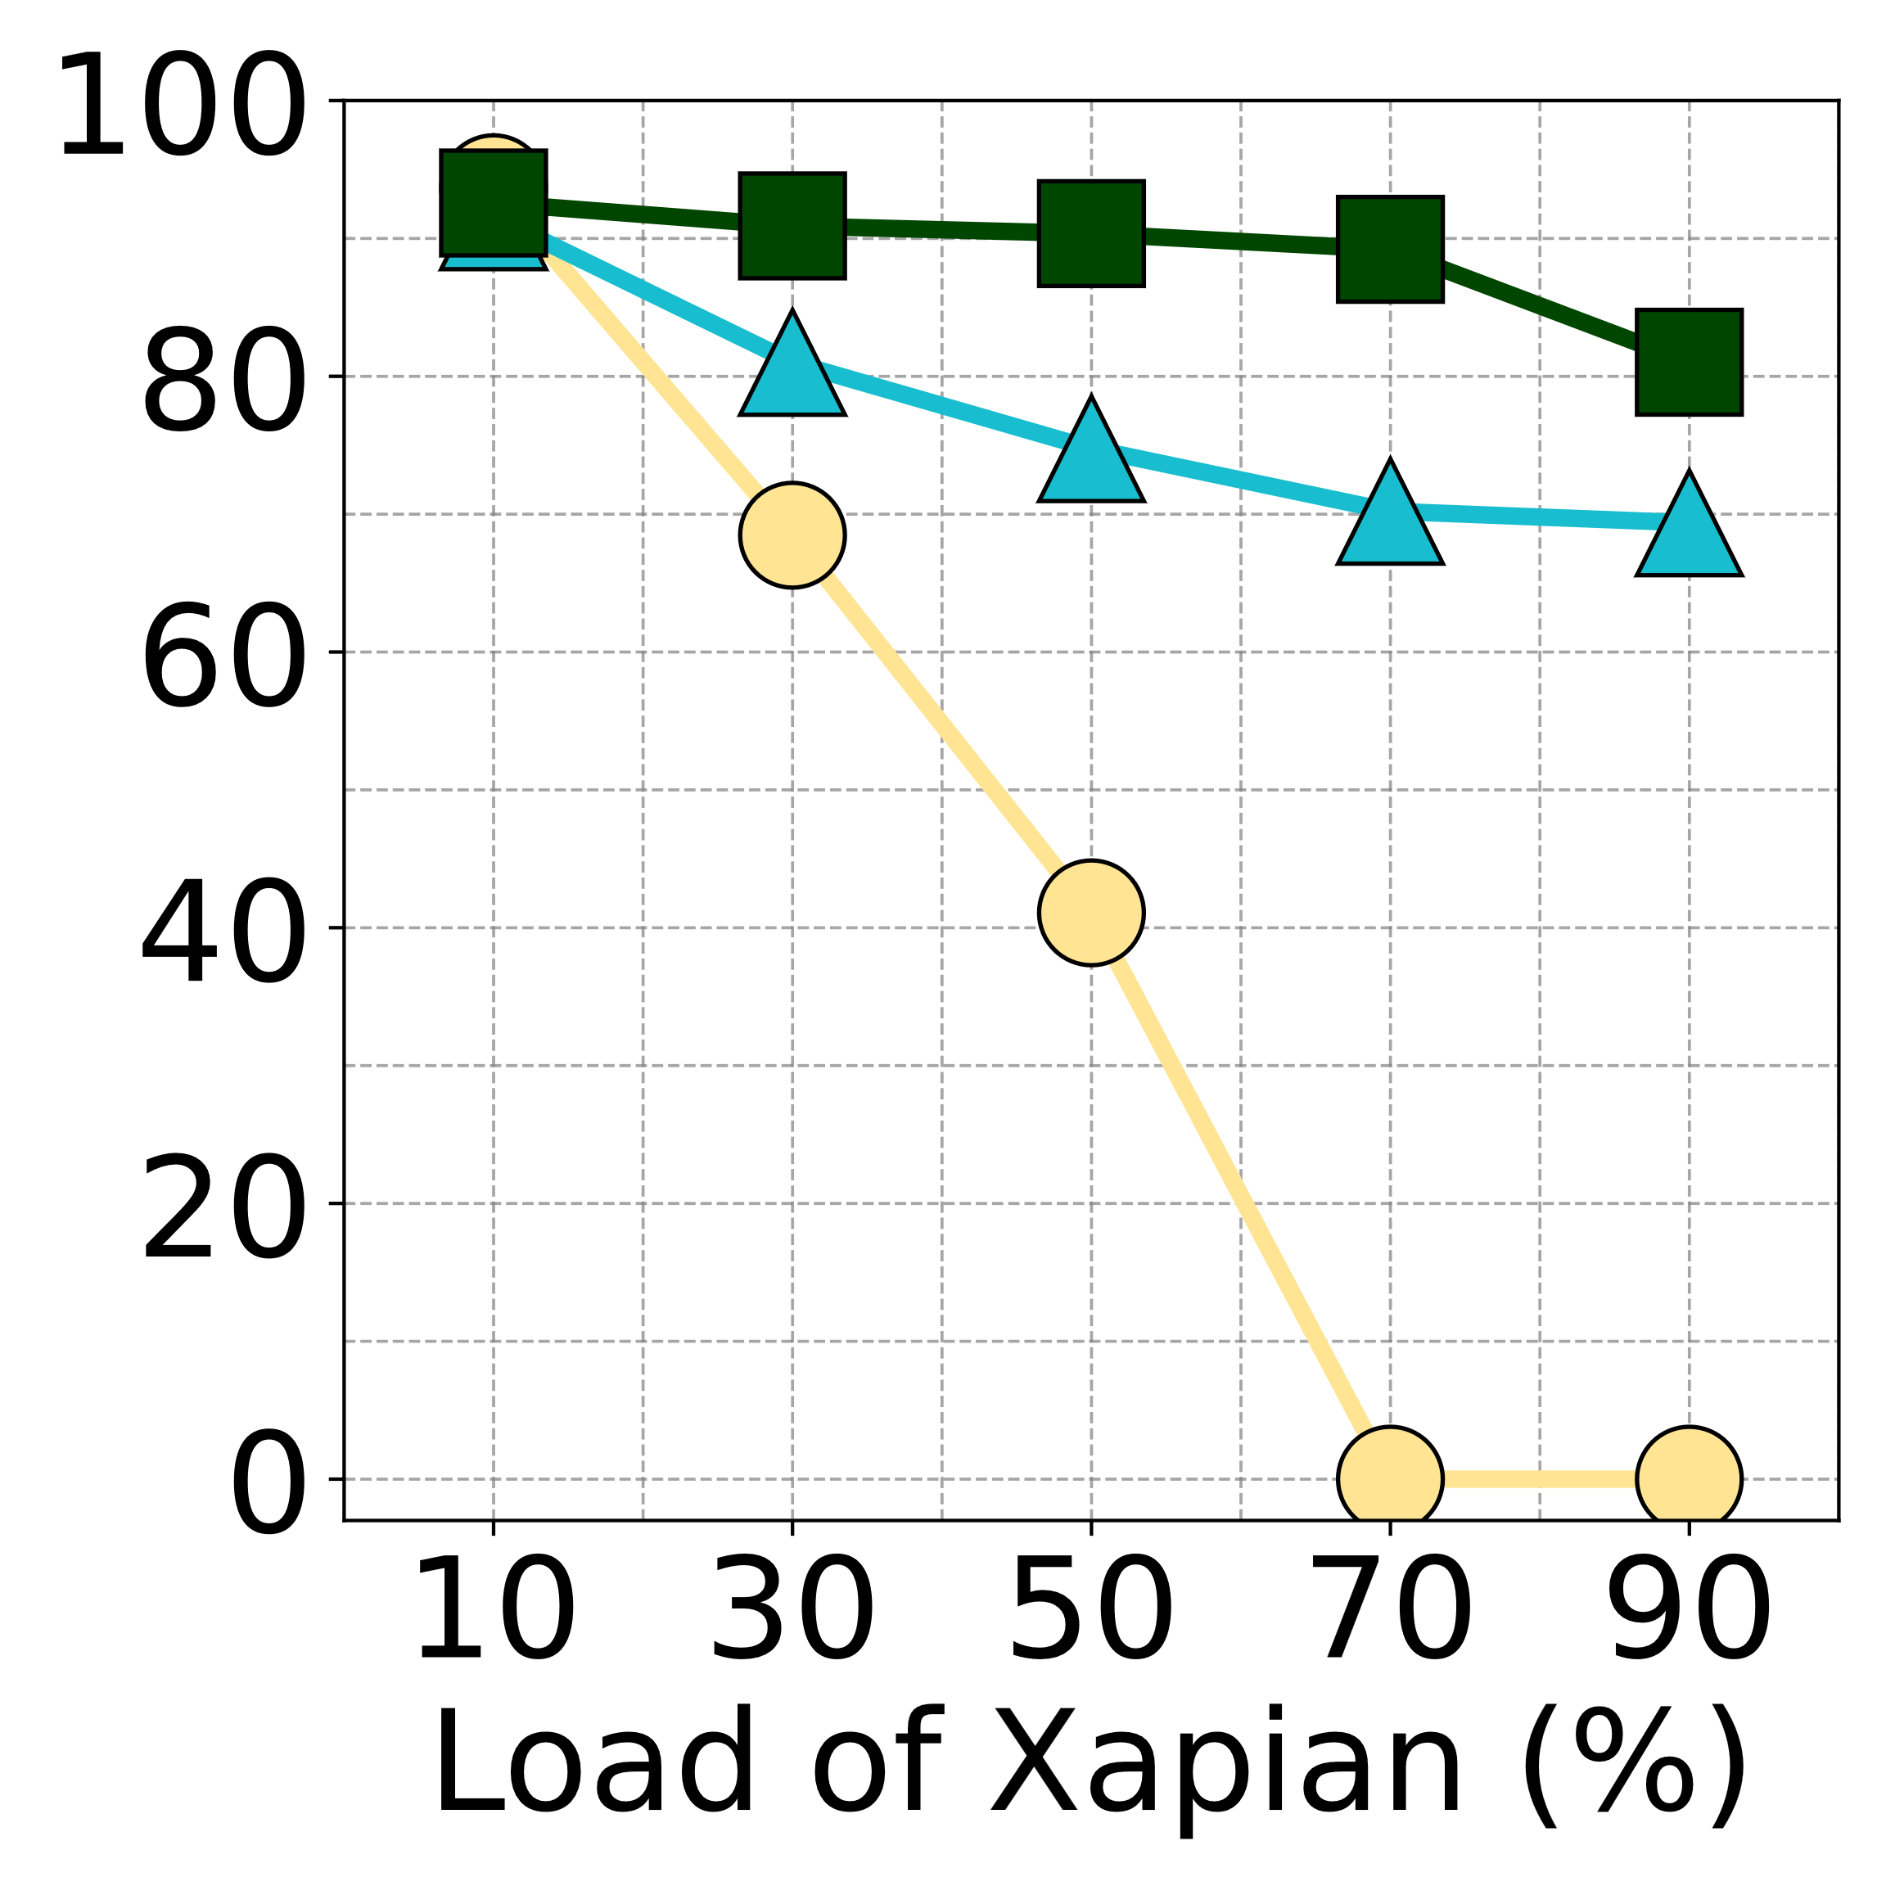
43
Evaluation
Increasing the throughput of the BE applications by up to 2.76× compared to MBA
Pivot improves efficient machine utilization (LC+BE) by up to 34.5%
LC+BE ↑ 34.5%
Notes:
Pivot also improves efficient machine utilization, which is defined as the total throughput of LC and BE tasks, by up to 34.5%

Slide 44
44
Summary
Memory Bandwidth Contention
Existing mechanisms are not able to balance memory bandwidth utilization and QoS insurance
Pivot: A Criticality-aware instruction-centric bandwidth partitioning mechanism
Insight #1: Full priority
Insight #2: Prioritizing performance-critical loads
Improving machine utilization by up to 34.5% while not causing QoS violation
Publicly available: https://github.com/TELOS-syslab/Pivot
Thank you!
Notes:
To conclude, our analysis shows that existing mechanisms are not able to balance memory bandwidth utilization and QoS insurance
So, We propose pivot, an instruction-centric approach with two insights,
First, the priority must be enforced across all shared components.
Second, we can prioritize a portion of performance-critical loads
Pivot improves machine utilization by up to 34.5% while not causing QoS violation
Our artifact is available on our GitHub.

Slide 46
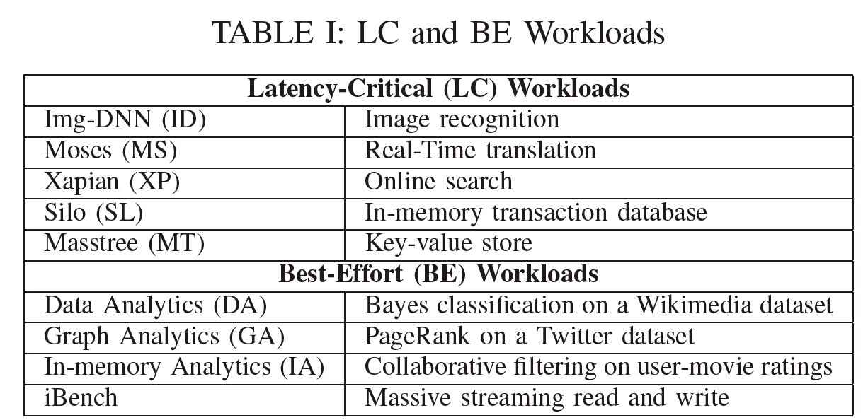
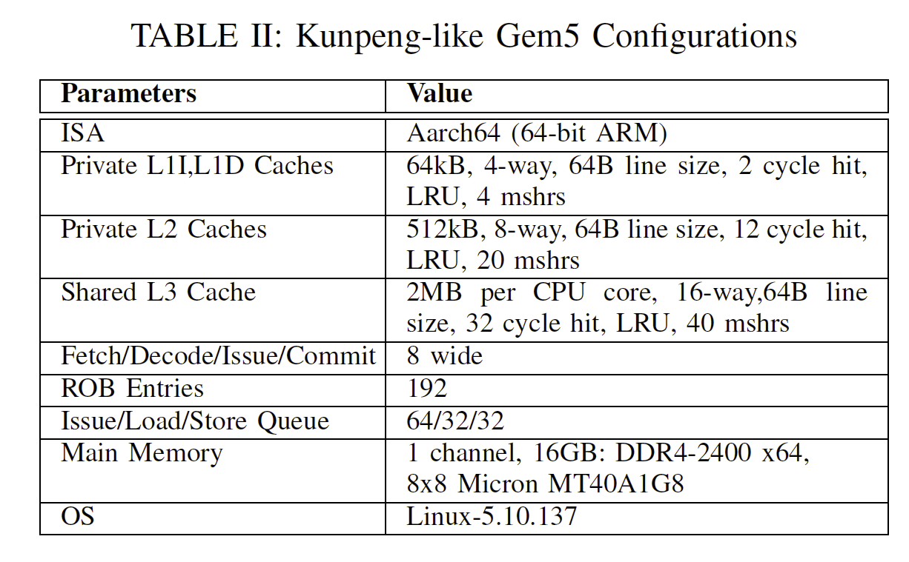
46
Evaluation Setup
Notes:
To evaluate Pivot, we use Gem5 to mode Huawei Kunpeng920.
In this talk, we will present part of experiments that use Tailbench as LC tasks and iBench as BE tasks.
Backup slides

